Slide 1
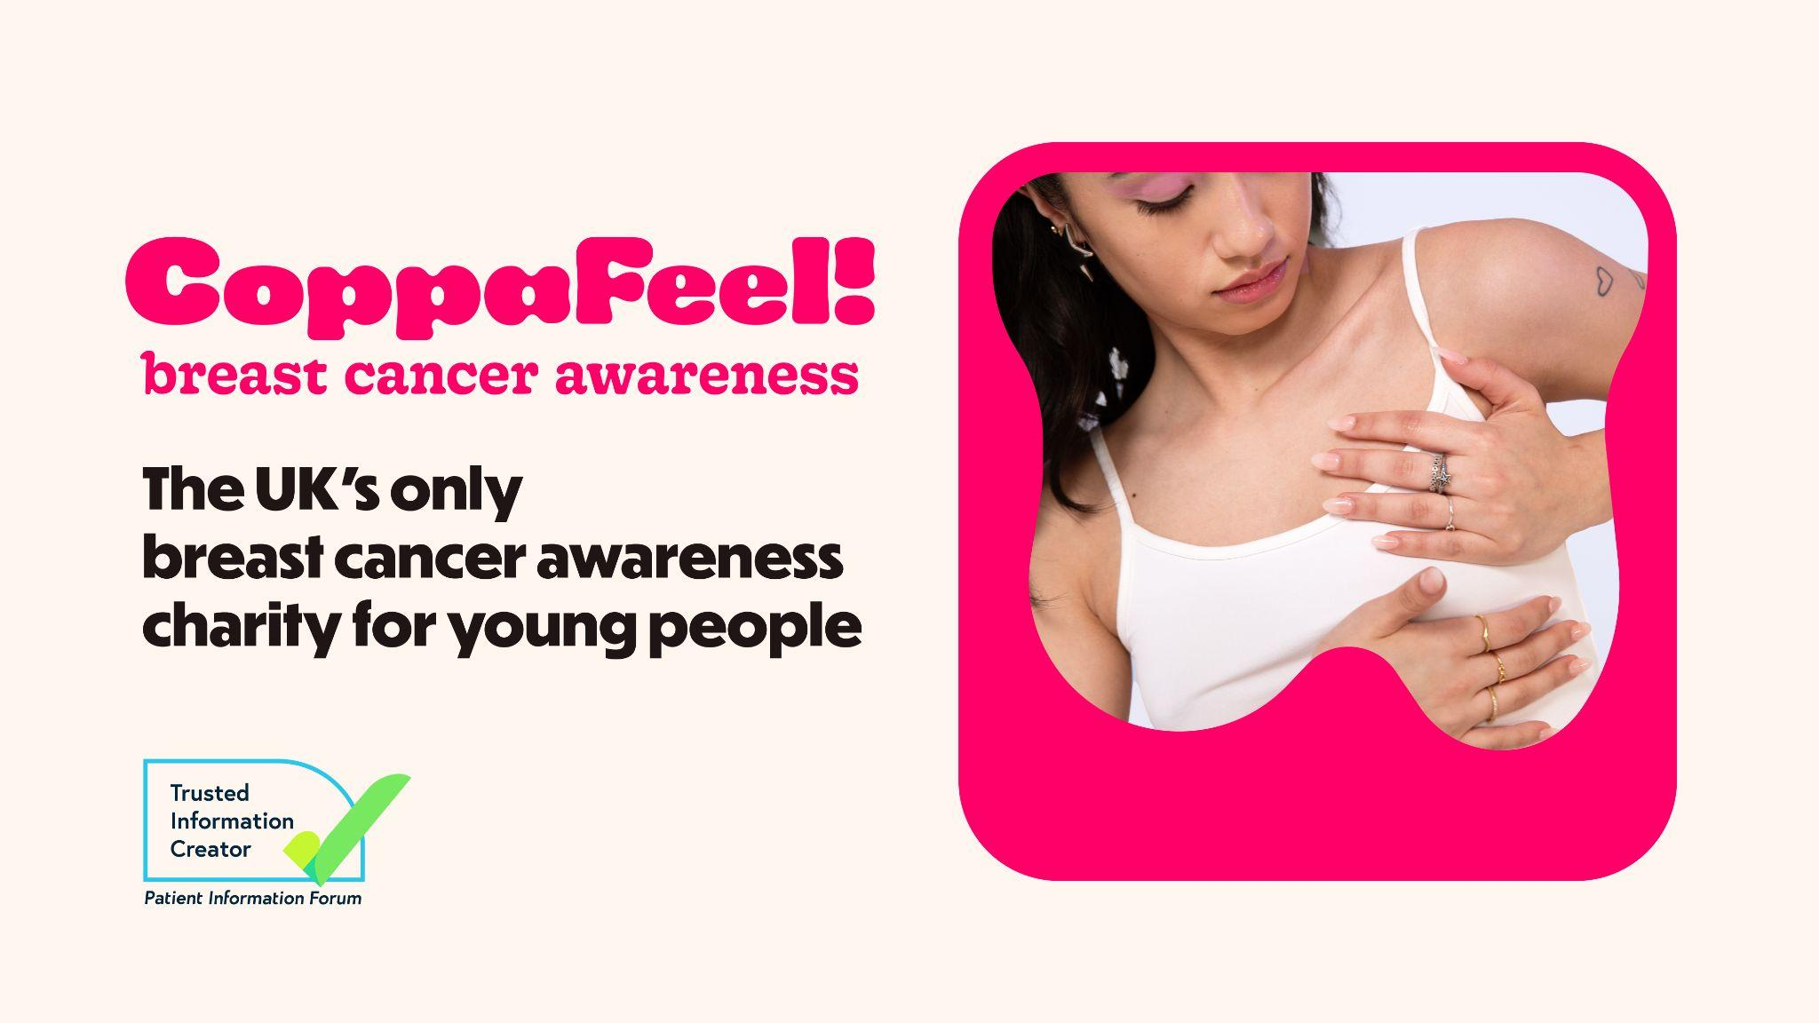
Notes:
Slide 1: Start slide
Leave this slide up while people are entering the room and before you start!

Slide 2
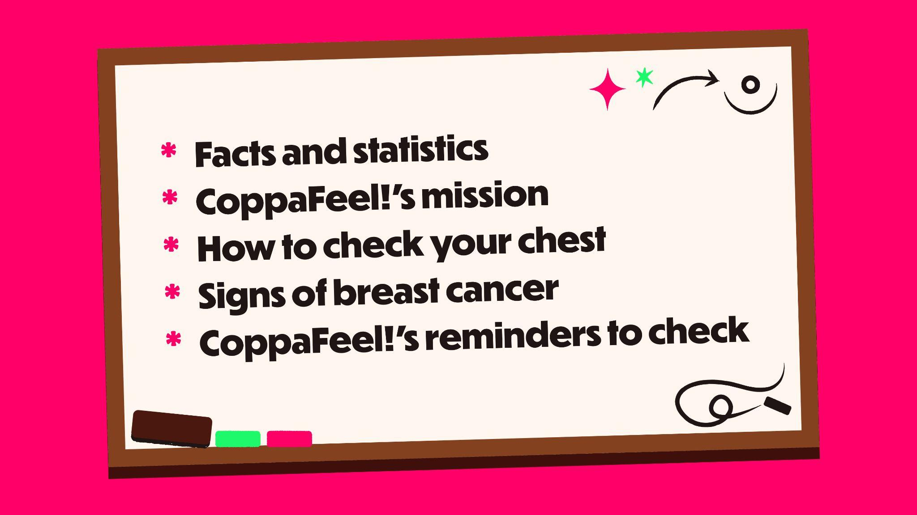
Notes:
Slide 2: Session overview
Today’s lesson is brought to you by CoppaFeel!, the UK’s only youth focused breast cancer awareness charity.
In this lesson we’ll be learning:
What breast cancer is
Key breast cancer statistics
How to check your chest
Signs of breast cancer
How CoppaFeel! can remind you to check every month

Slide 3

Notes:
Slide 3: Content disclaimer
We know that cancer is a sensitive subject, and some people may find the topics we talk about today upsetting. If that’s the case, please feel free to…
[choose the most appropriate option depending on the setting].
Schools: step outside and speak to a teacher
Youth group: step outside and speak to a trusted adult
A note on terms: Throughout the presentation we’ll use the term [choose one: boobs, breast, pecs, chest] but it’s important to say that breast cancer can happen to people of all genders. You might use a different term to the one being used and that’s ok! Whatever term you use, we’re referring to the area from your rib cage, all the way up to your collarbone and under your armpits, including your nipples.

Slide 4
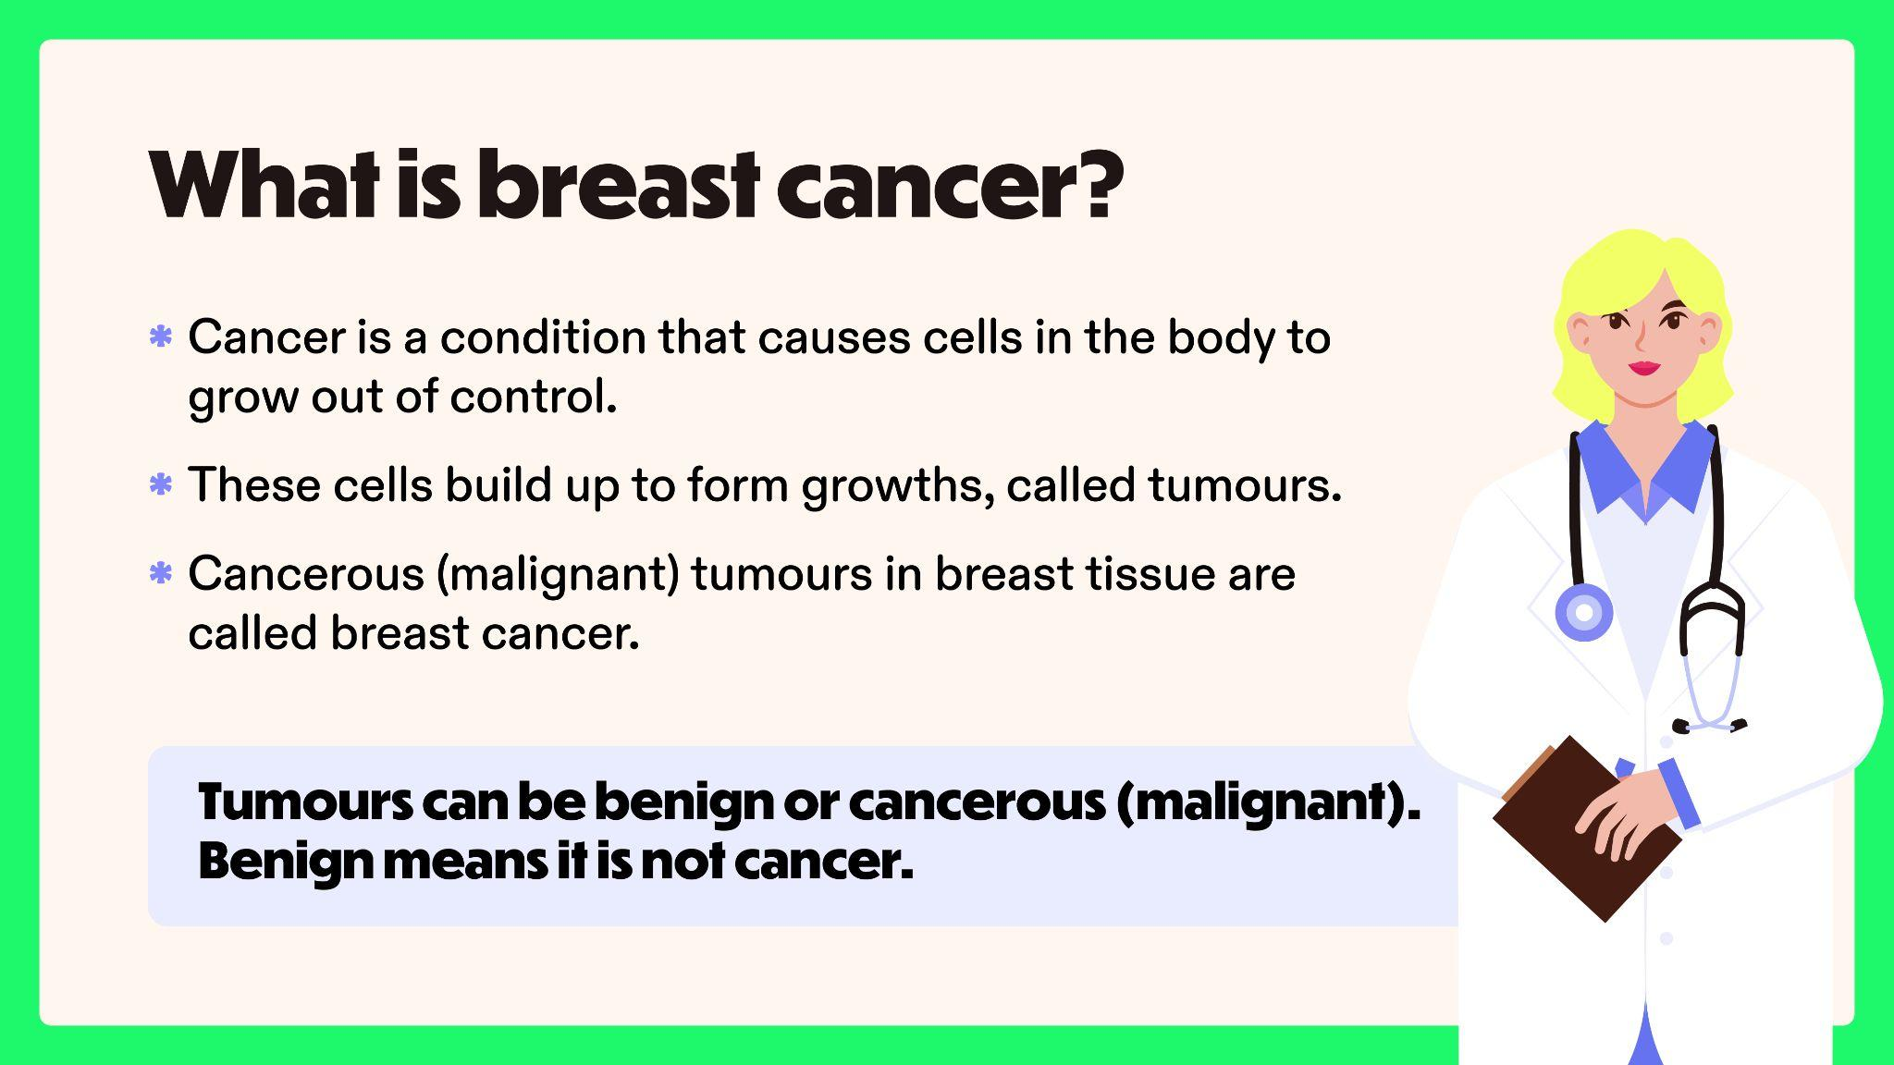
Notes:
Slide 4: What is breast cancer?
So, what IS breast cancer?
Cancer is a condition that causes cells in the body to grow out of control.
These cells build up to form growths, called tumours.
Cancerous (malignant) tumours in breast tissue are called breast cancer.
Tumour can be benign or cancerous (malignant). Benign means it is not cancer.
Remember that your breast tissue involves the front part of your body – your chest.

Slide 5
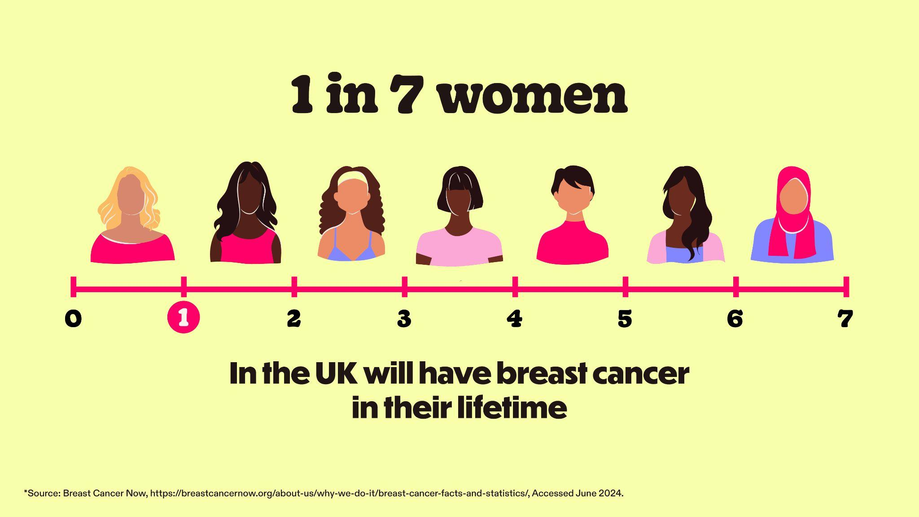
Notes:
Slide 5: Breast cancer statistics
In the UK…
1 in 7 women will have breast cancer in their lifetime.
This means just over 55,000 women are diagnosed every year.

Slide 6

Notes:
Slide 6:
Statistics can be hard to visualise. But this statistic means that in a classroom of 30 women, roughly 4 will have breast cancer in their lifetime.

Slide 7
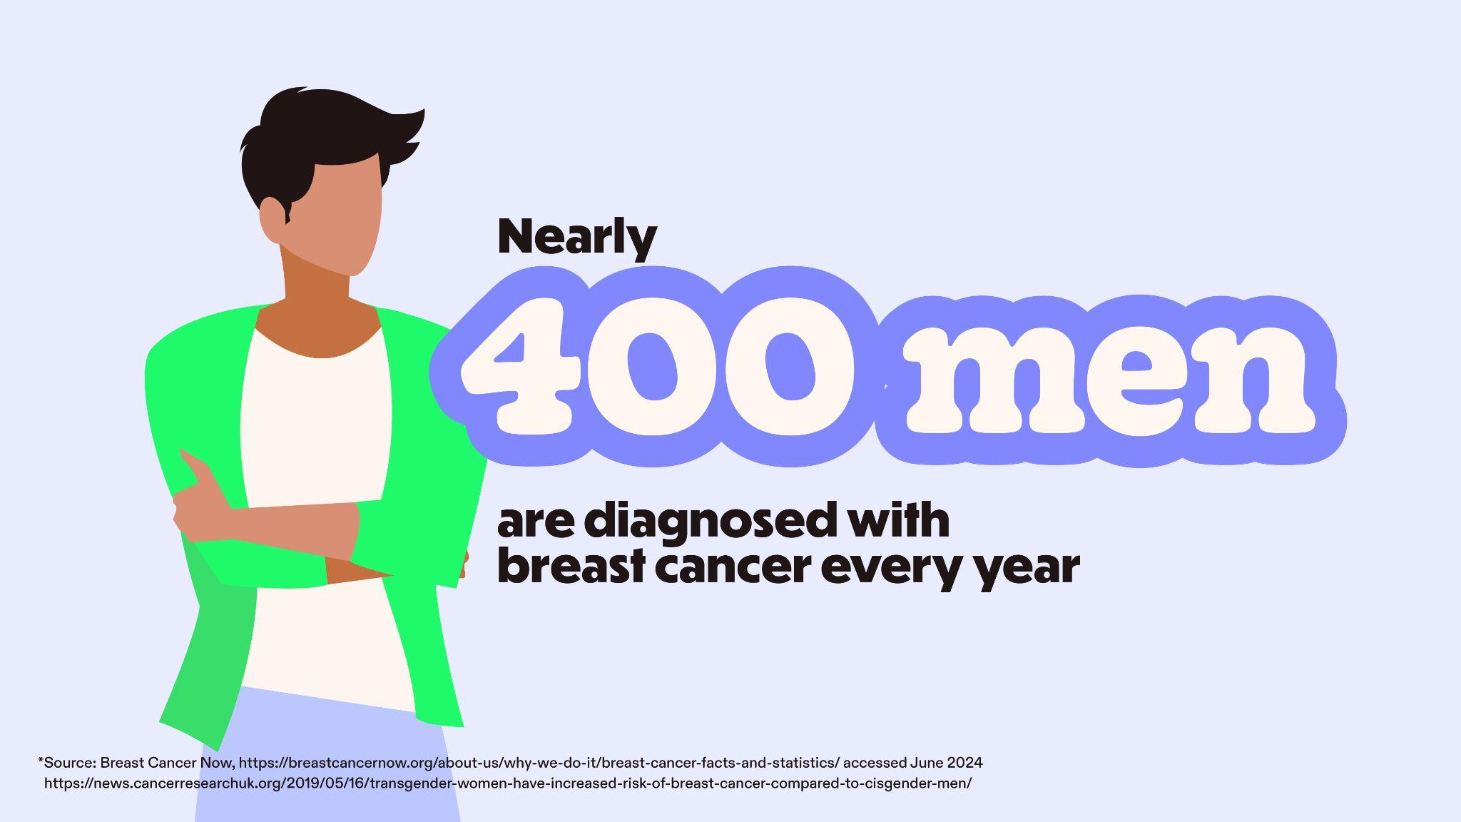
Notes:
Slide 7: Breast cancer can affect people of all genders
Breast cancer can affect people of ALL genders, and whilst more common in women, nearly 400 men are diagnosed every year in the UK.
Research on breast cancer in transgender people is limited. What we do know is that everyone has breast tissue so whatever your gender, we want you to be checking your chest!

Slide 8

Notes:
Slide 8: Breast cancer in young people
You might be sitting here thinking, well what does this all have to do with me? I'm young!
Although breast cancer is rarer in younger people, it still happens.
In fact, it’s the most common cancer for females aged 15 to 44 and around 2,500 people under the age of 40 are diagnosed every year in the UK.

Slide 9
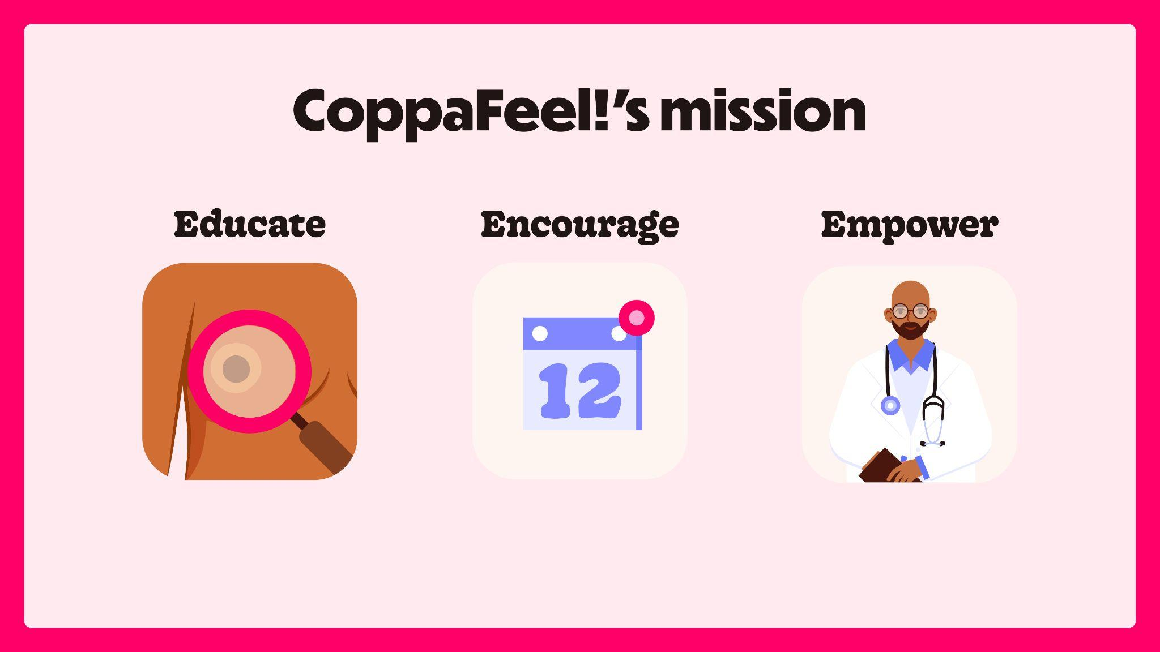
Notes:
Slide 9: Our mission
CoppaFeel!’s mission is all about the early diagnosis of breast cancer. The charity was founded in 2009 by Kris Hallenga and her twin sister Maren, after
Kris was diagnosed with incurable (stage 4/secondary) breast cancer at the age of 23. Kris was struck by the limited information available for young people and so, CoppaFeel! was born.
That’s why I’m delivering this lesson today to educate, encourage and empower you!
Educate you on the signs of breast cancer
Encourage you to check your chest monthly,
Empower you to talk to your GP if you ever notice anything that’s not normal for you.

Slide 10
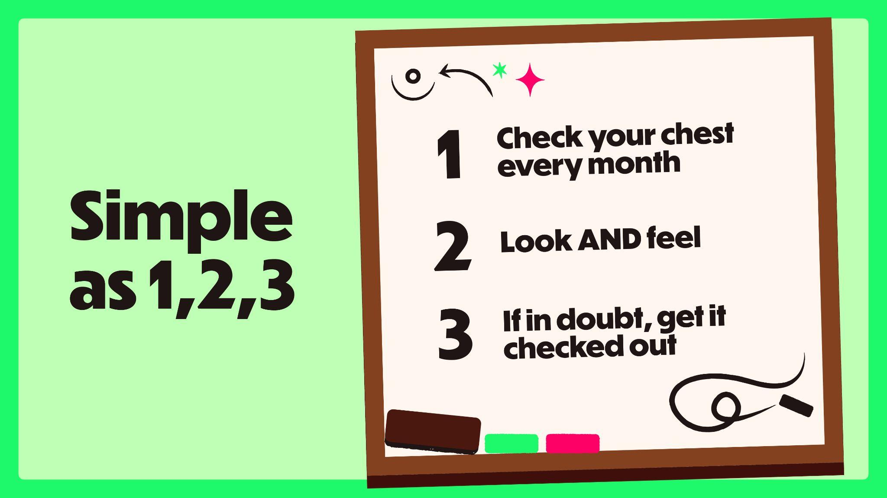
Notes:
Slide 10: As simple as 1,2,3
Well, it’s as simple as 1, 2, 3:
Check your chest every month
Both look AND feel, and;
If in doubt, get it checked out and talk to your GP.
If breast cancer is caught early, treatments are more effective, and survival rates are higher.
What you can see is as important as what you can feel, so remember to look AND feel when checking your chest.

Slide 11
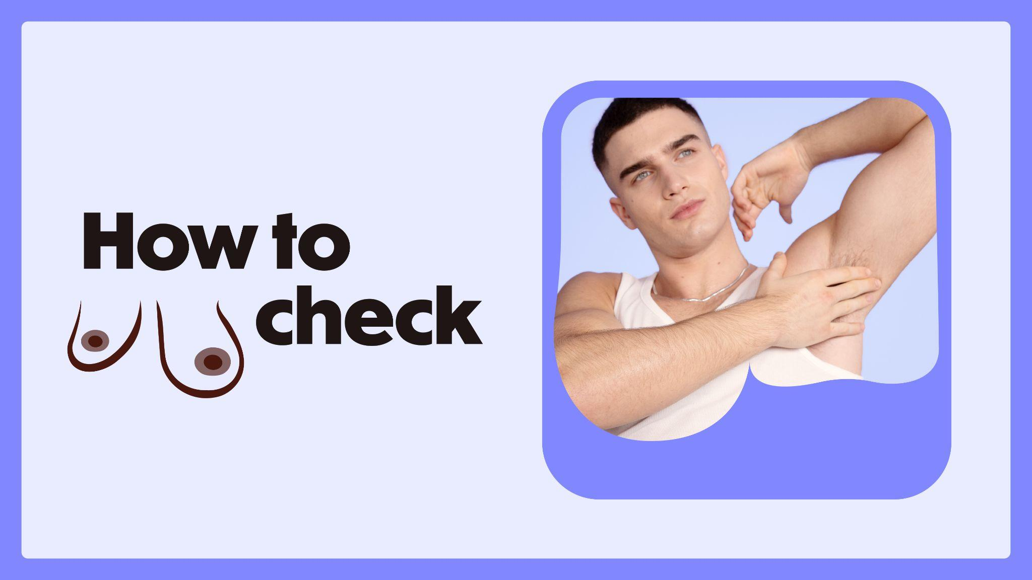
Notes:
Slide 11: How to check
There isn’t a specific way to check and everyone’s ‘normal’ will be different.
You can check in any way that feels right for you – in the shower, when you’re lying down in bed or in the mirror when you’re getting dressed.
The key is to make it part of your normal routine, so you’ll notice any unusual changes quickly.
By checking every month, you’ll feel more confident about knowing what’s normal for you. Everyone has to start somewhere, so don’t worry if you don’t feel confident right away.
To give you some inspiration, let’s have a look at how you can make chest-checking a part of your routine…

Slide 12
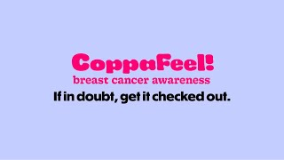
Notes:
Slide 12: How To Check video
[Hit the ‘play’ button or use the spacebar to play the checking video.]
Video problems?
If you’re having issues with the video playing in PowerPoint, play the video through your web browser via YouTube: https://www.youtube.com/watch?v=mv4gT6P5eN0&feature=youtu.be
Or if you want to re-embed the video into PowerPoint go to insert > video > online film > enter this URL https://www.youtube.com/watch?v=mv4gT6P5eN0&feature=youtu.be.

Slide 13
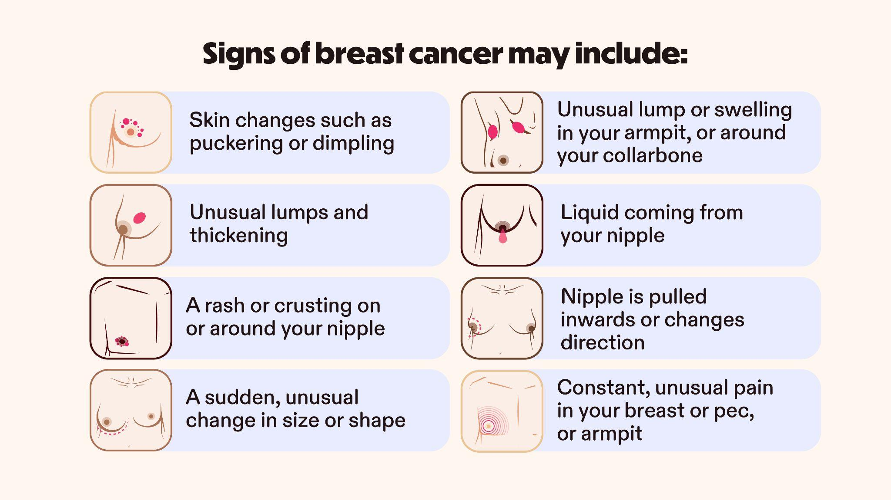
Notes:
Slide 13: Signs of breast cancer
Signs of breast cancer may include any of the things shown here on screen, or a mix of these.
Some of the signs you would only notice from looking at your chest, like liquid coming from your nipple, or a rash or crusting on or around your nipple.
Then there are signs you would only notice from having a feel, like unusual lumps and thickening.
These signs may look different on your skin tone or body. That’s why it’s important to get to know your own body, and what looks and feels normal for you.
Now don’t worry, you don’t have to remember all the signs; CoppaFeel! have created handy checking cards and shower stickers to help you get clued up on the signs of breast cancer…
This is a good opportunity to signpost to, or hand out some CoppaFeel! resources for students to take away with them.

Slide 14

Notes:
Slide 14: Natural changes
Our bodies are always changing.
Chests come in all shapes and sizes. The size of your chest doesn’t affect your risk of breast cancer.
You may have different sized breasts, nipples that point in different directions or nipples with hair around them. If they’ve always been that way and it’s normal for you, then you don’t need to worry.
If you have periods, you might notice natural changes in your chest because of changes in your hormones during your monthly cycle. It’s normal for your breasts to feel tender, sore or swollen around your period.
And finally, some lumps are perfectly normal, but if you get a new lump or a lump comes back, contact your GP.
To find out more about natural chest changes visit the CoppaFeel! website.

Slide 15
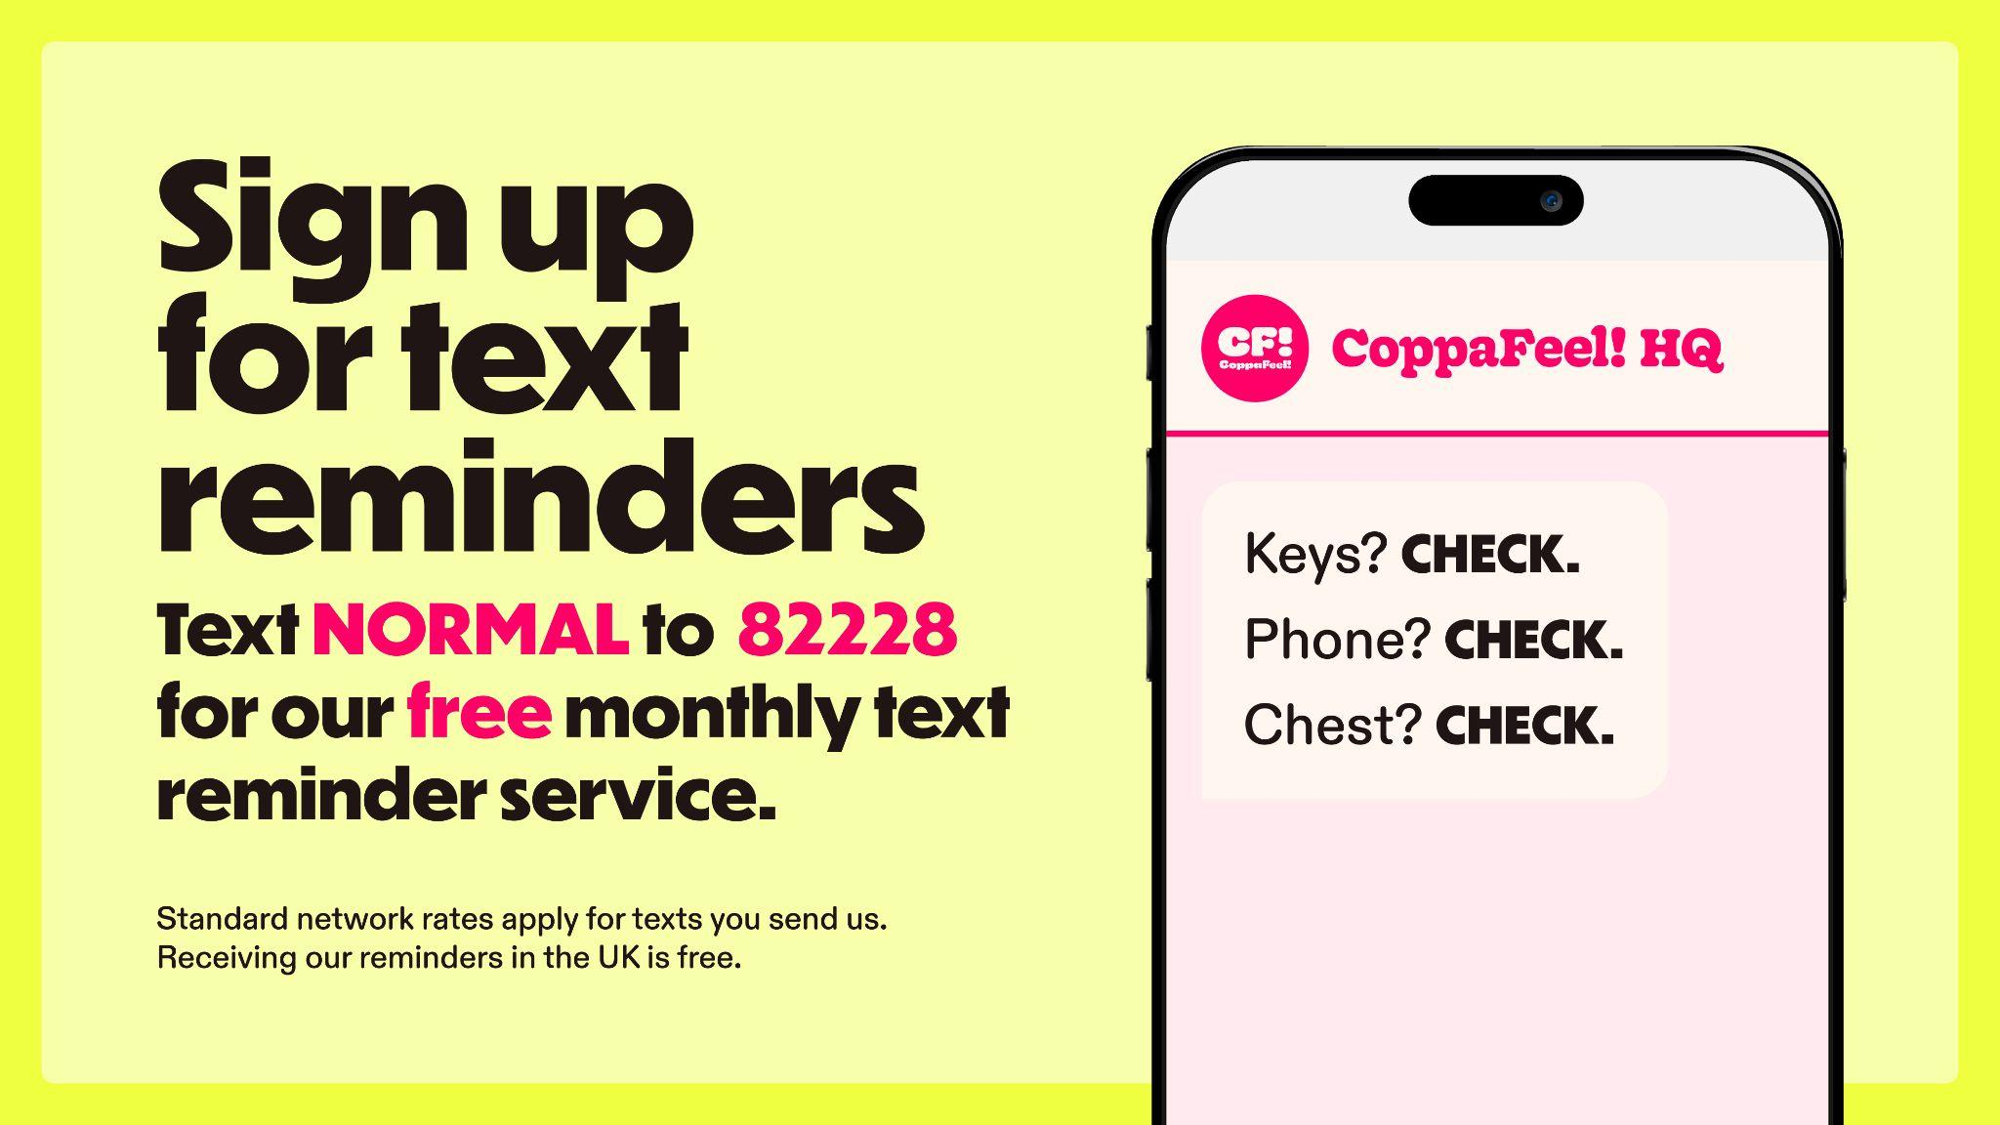
Notes:
Slide 15: Text reminder service
One of the most common reasons for people not checking monthly is that they forget, so CoppaFeel! have some fun ways to remind you:
They can send you a text reminder for free every month to get you checking. Text NORMAL to 82228 to sign up and get a text from once a month. They are usually a little bit silly and include a joke or poem.
One of the most common places people check is in the shower, so they also have shower stickers to remind you to have a good look and feel when you lather up.
Don’t forget, you can grab one from me on your way out.

Slide 16

Notes:
Slide 16: End
I hope you’re all feeling more educated and empowered after this lesson to go away and making chest checking a part of your monthly routine.
If you’re ever worried about an unusual change in your chest, book an appointment with a GP.
If you would like more information after this lesson, head to CoppaFeel!’s website (coppafeel.org) which has loads of useful guidance and information. You can also come and grab some handy checking resources from me.
If you have time to do a recap:
So let’s recap.
One, check your chest every month.
This helps you to know what your body looks and feels like, so you’ll notice any unusual changes quickly. You can check in the shower, when you are getting dressed, while applying lotion, or lying down in bed – just make it part of your normal routine. Remember, there isn’t a specific way to check and everyone’s ‘normal’ will be different.
Two, look and feel.
Many of the signs of breast cancer are changes you would only notice by seeing how your chest looks so we recommend coppin’ a feel and taking a look during your monthly checks. Remember, everyone has breast tissue which goes from your rib cage, all the way up to your collarbone and under your armpits, including your nipples, so check this whole area.
And Three, if in doubt, get it checked out.
Early detection is the best form of defence. If you find something that’s unusual for you, don’t panic. There are lots of reasons why there might be changes but it’s always best to get it checked out by your GP.
[Woo! THANK YOU for helping us educate more people about the importance of chest checking and potentially, saving lives! You’ve just done something BRILLIANT so we recommend treating yourself and take a moment to recognise your contribution to our life-saving mission.]

