Slide 1
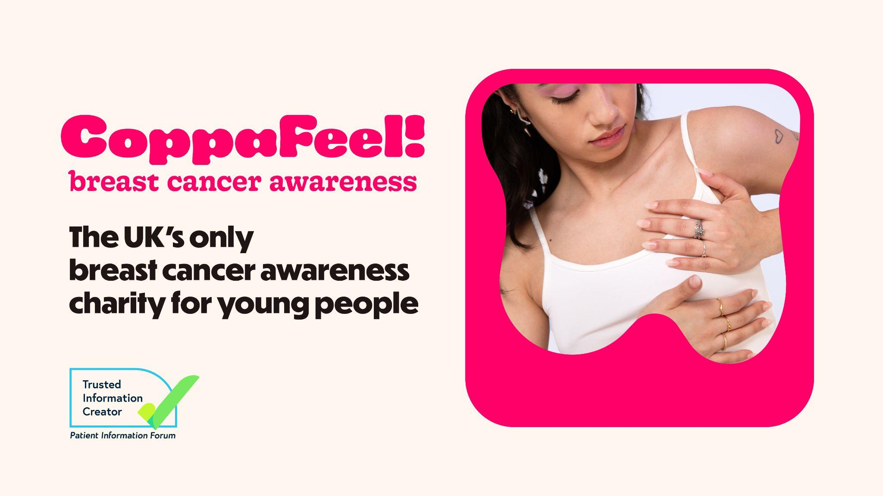
Notes:
Slide 1: Start slide
Leave this slide up while people are entering the room and before you start!

Slide 2
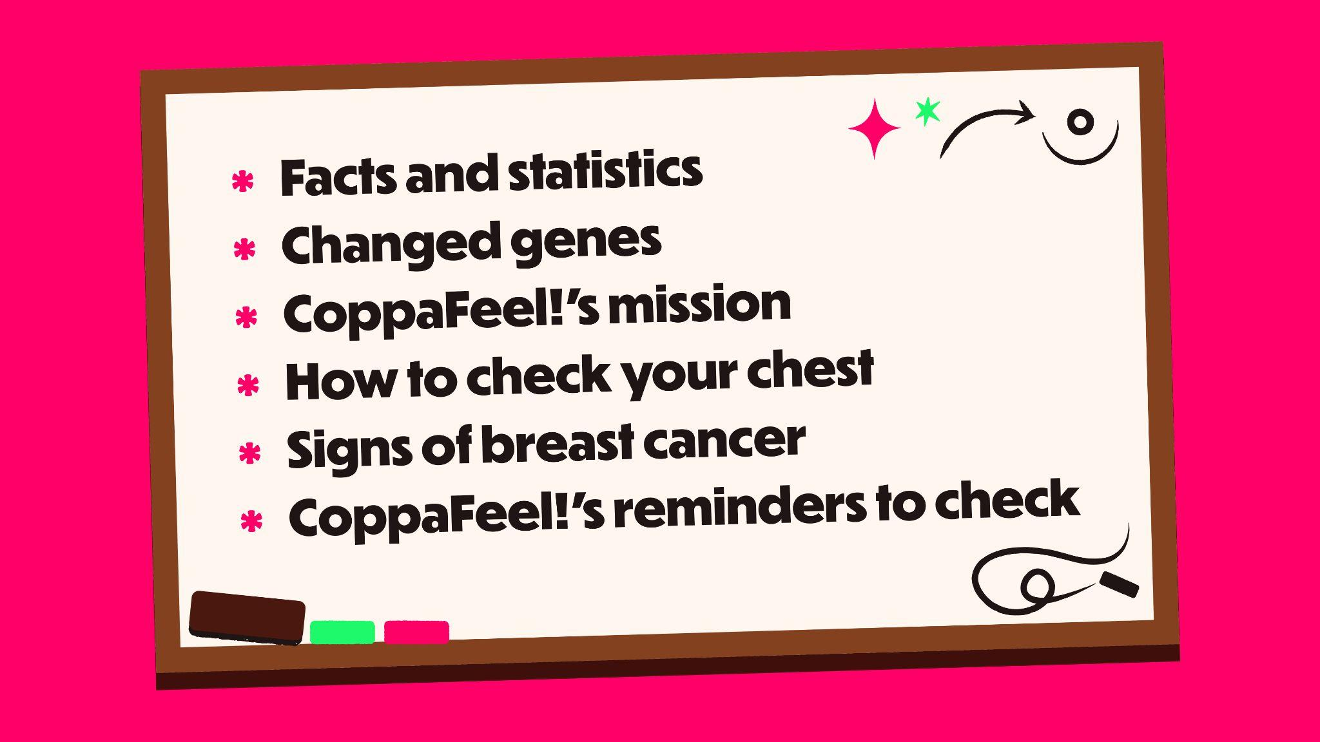
Notes:
Slide 2: Session overview
Today’s lesson is brought to you by CoppaFeel!, the UK’s only youth focused breast cancer awareness charity.
In this lesson we’ll be learning:
What breast cancer is
Key breast cancer statistics
Changed genes and inherited risk
How to check your chest
Signs of breast cancer
How CoppaFeel! can remind you to check every month

Slide 3

Notes:
Slide 3: Content disclaimer
We know that cancer is a sensitive subject, and some people may find the topics we talk about today upsetting. If that’s the case, please feel free to…
[choose the most appropriate option depending on the setting].
Schools: step outside and speak to a teacher
Youth group: step outside and speak to a trusted adult
A note on terms: Throughout the presentation we’ll use the term [choose one: boobs, breast, pecs, chest] but it’s important to say that breast cancer can happen to people of all genders. You might use a different term and that’s ok! Whatever term you use, we’re referring to the area from your rib cage, all the way up to your collarbone and under your armpits, including your nipples.

Slide 4
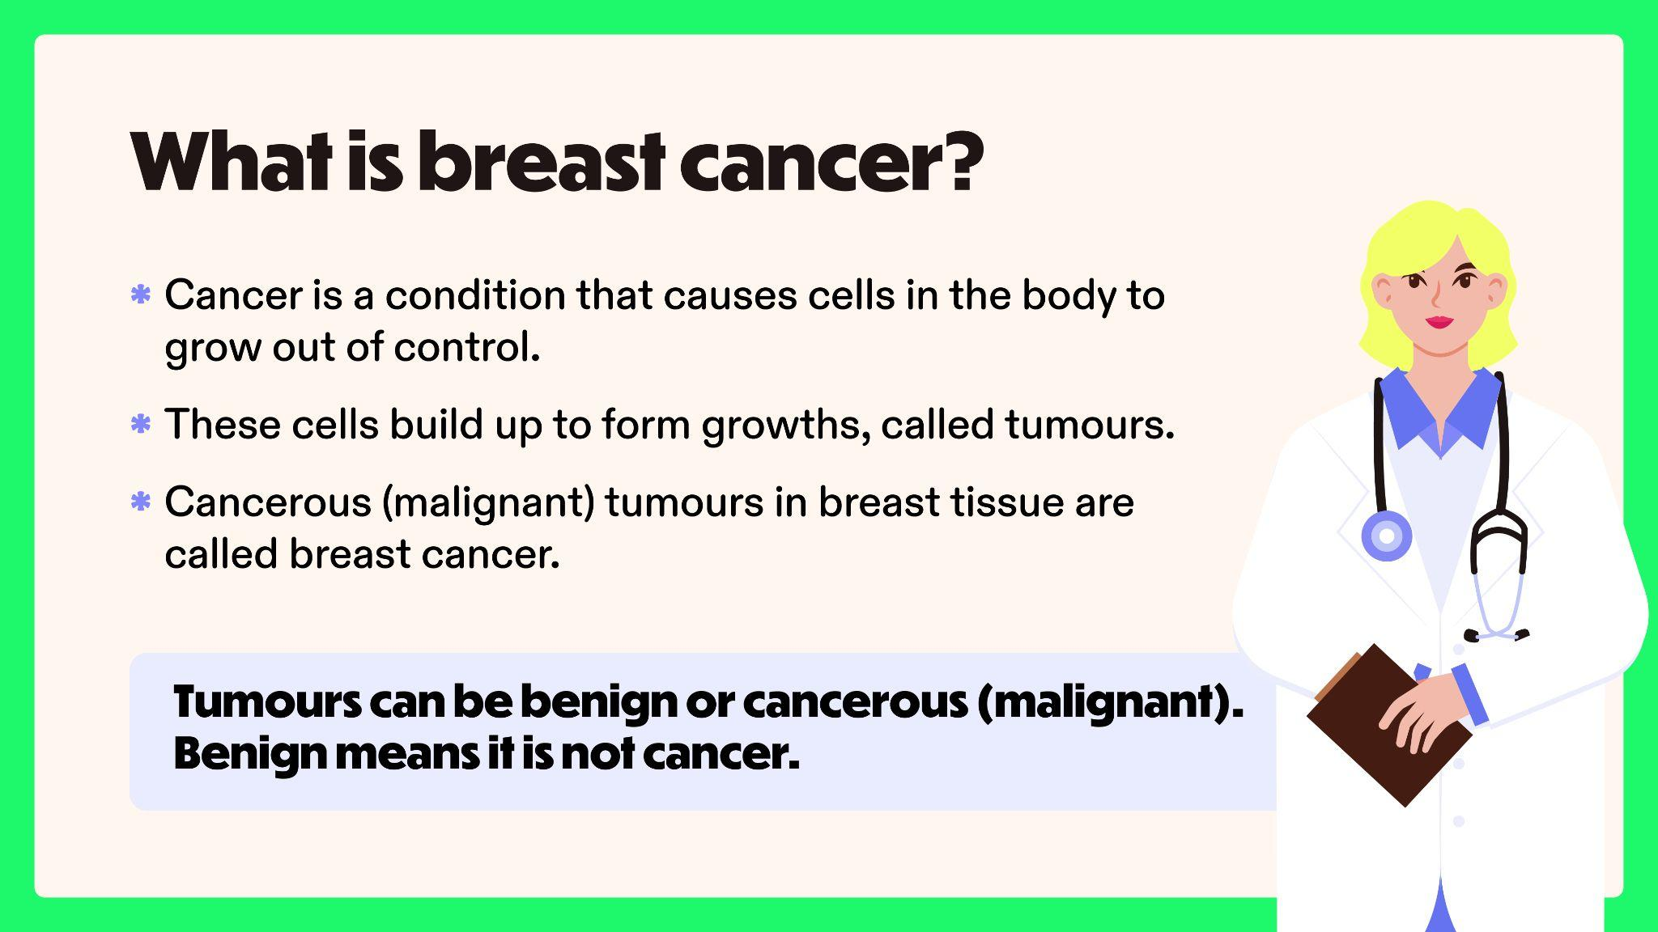
Notes:
Slide 4: What is breast cancer?
So, what IS breast cancer?
Cancer is a condition that causes cells in the body to grow out of control.
These cells build up to form growths, called tumours.
Cancerous (malignant) tumours in breast tissue are called breast cancer.
Tumour can be benign or cancerous (malignant). Benign means it is not cancer.
Remember that your breast tissue involves the front part of your body – your chest.

Slide 5
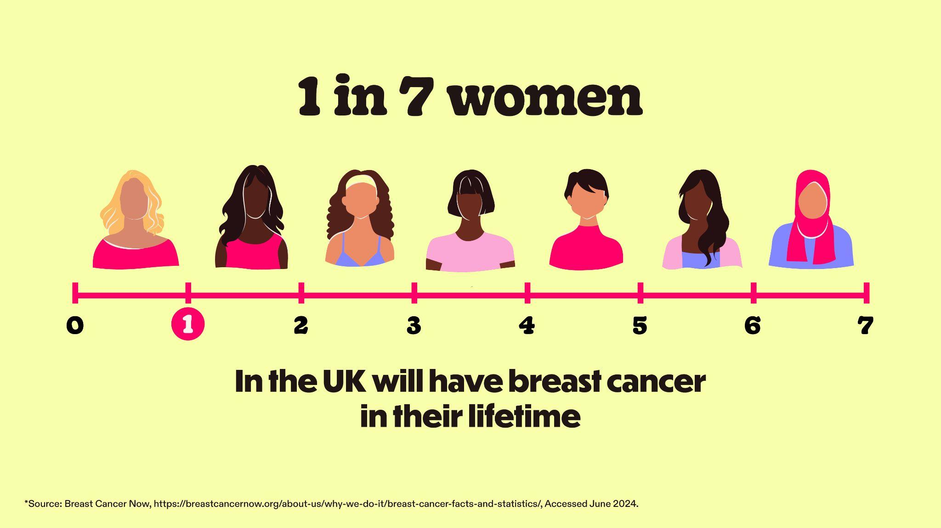
Notes:
Slide 5: Breast cancer statistics
In the UK…
1 in 7 women will have breast cancer in their lifetime. That’s about 15% of women.
This means just over 55,000 women are diagnosed every year.

Slide 6

Notes:
Slide 6:
Statistics can be hard to visualise. But this statistic means that in a classroom of 30 women, roughly 4 will have breast cancer in their lifetime.

Slide 7
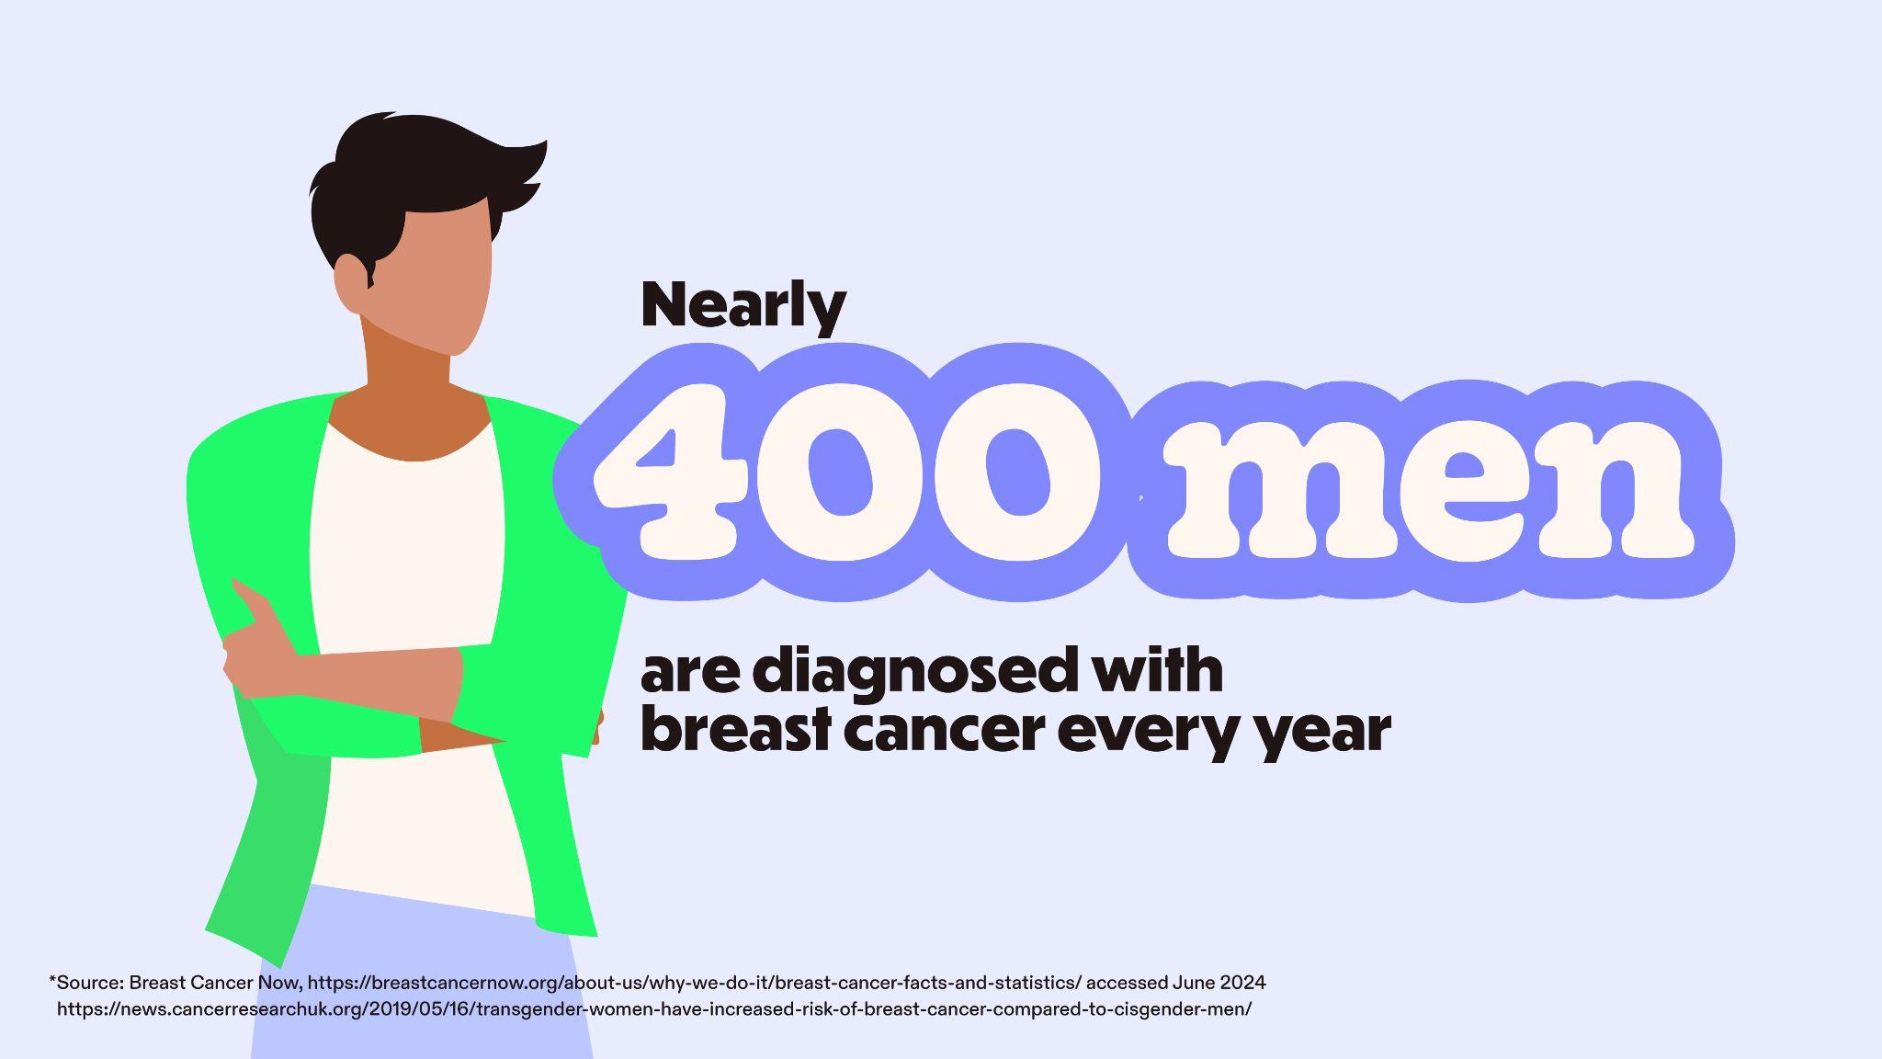
Notes:
Slide 7: Breast cancer can affect people of all genders
Breast cancer can affect people of ALL genders, and whilst more common in women, nearly 400 men are diagnosed every year in the UK.
Research on breast cancer in transgender people is limited. What we do know is that everyone has breast tissue so whatever your gender, we want you to be checking your chest!

Slide 8
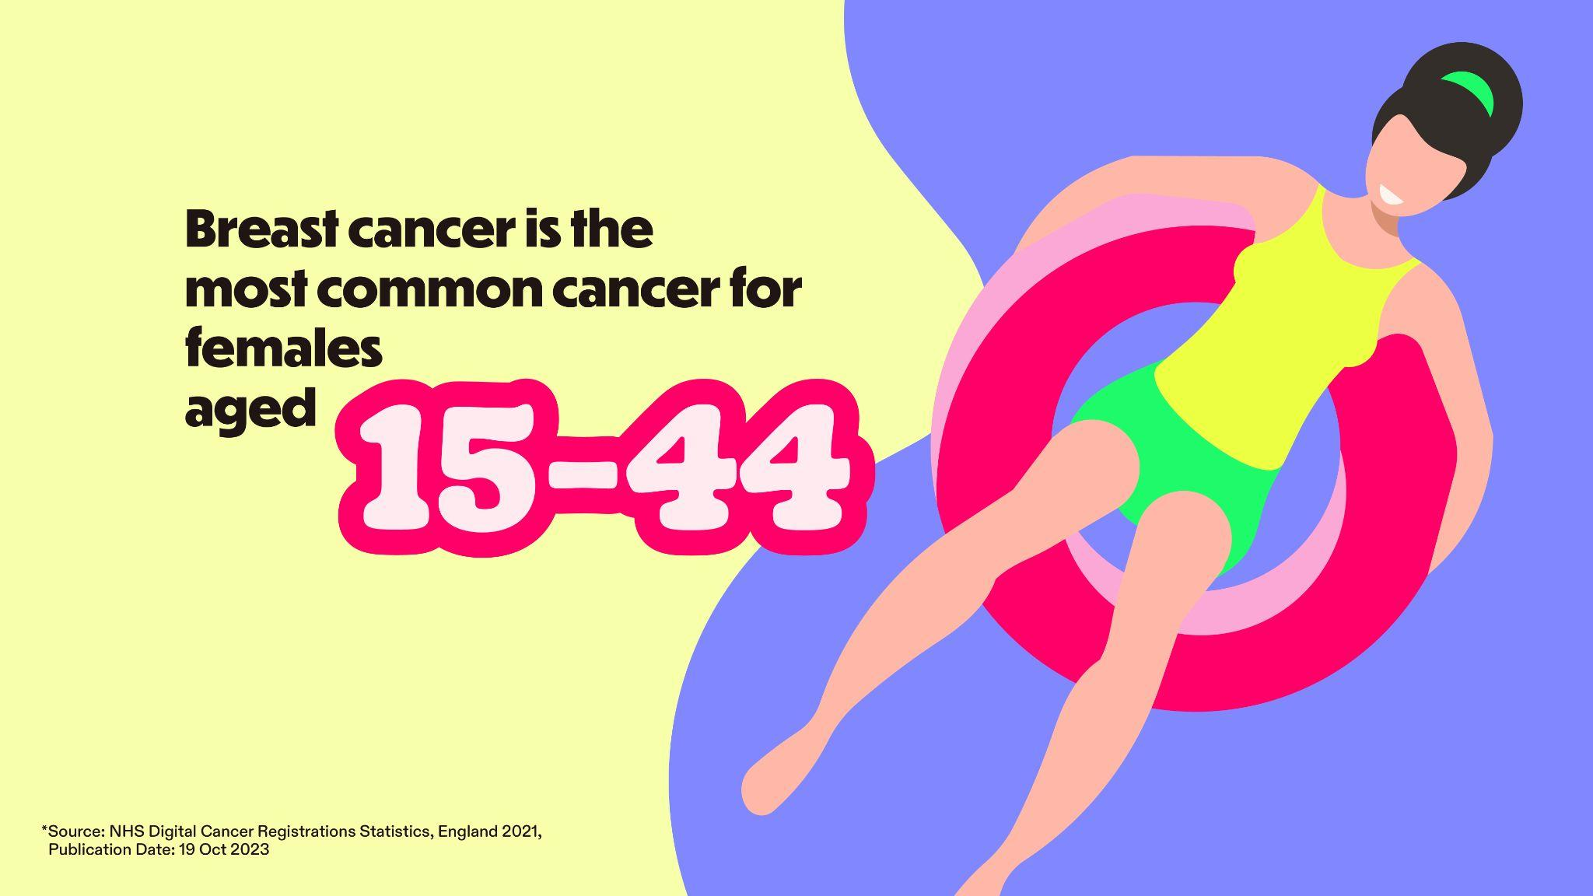
Notes:
Slide 8: Breast cancer in young people
You might be sitting here thinking, well what does this all have to do with me? I'm young!
Although breast cancer is rarer in younger people, it still happens.
In fact, it’s the most common cancer for females aged 15 to 44 and around 2,500 people under the age of 40 are diagnosed every year in the UK.

Slide 9
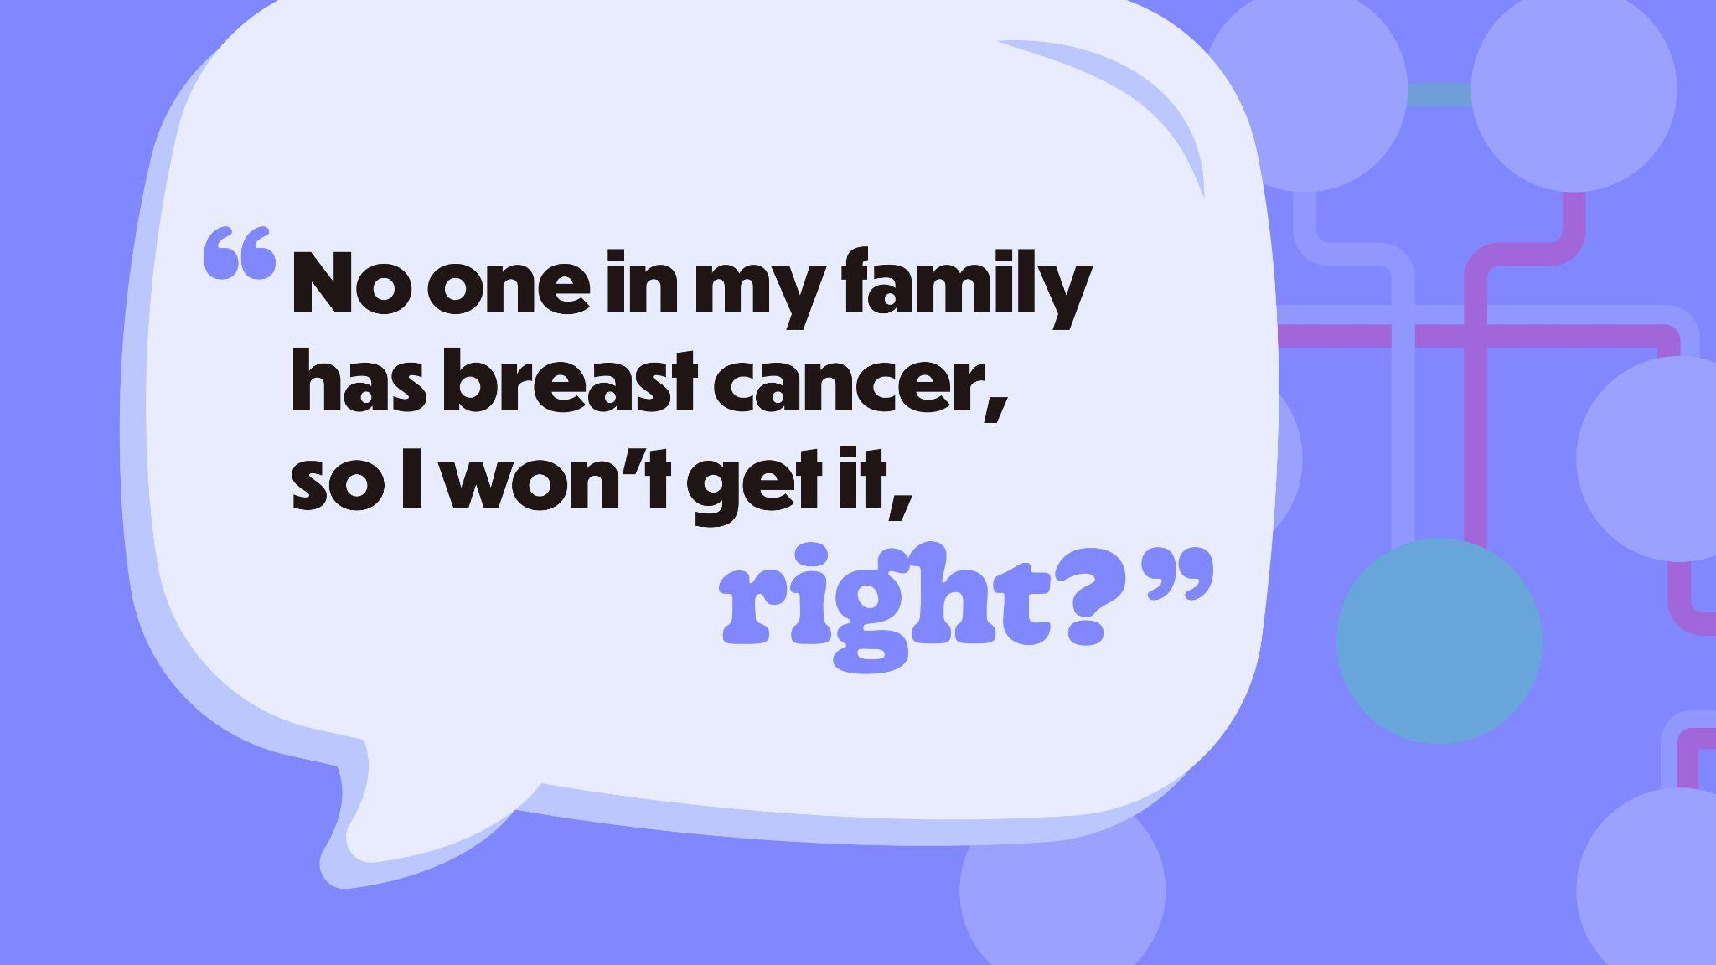
Notes:
Slide 9: Family history
“No one in my family has breast cancer, so I won’t get it…right?” is something we often hear so I’m going to explain how your family history impacts your risk of cancer.
We all have genes which are ‘inherited’, this means they’re passed down from our parents. Genes give instructions for how our body works and we all have genes that protect us from cancer.
Some people inherit a changed gene which means it can’t fix damaged cells in the body. If too many damaged cells build up, they can form a tumour. Sometimes, this tumour is dangerous and can turn into cancer.
Having a changed gene doesn’t mean you have breast cancer, but it does mean your risk of getting breast cancer is much higher, and between 50 – 90% higher than someone without a changed gene.

Slide 10

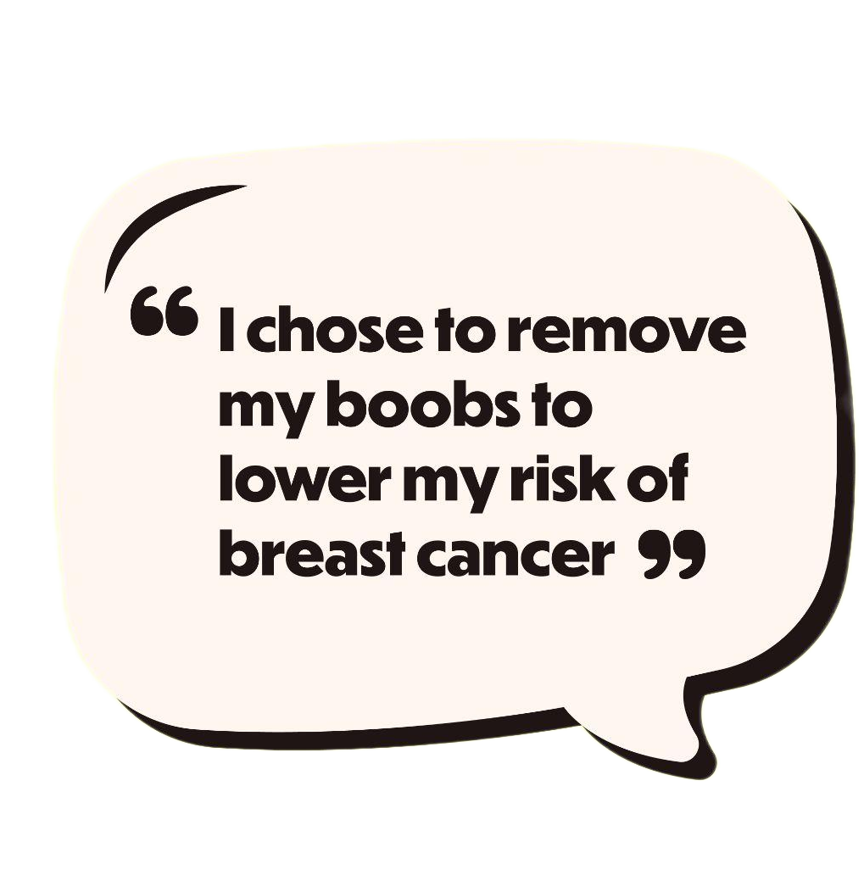
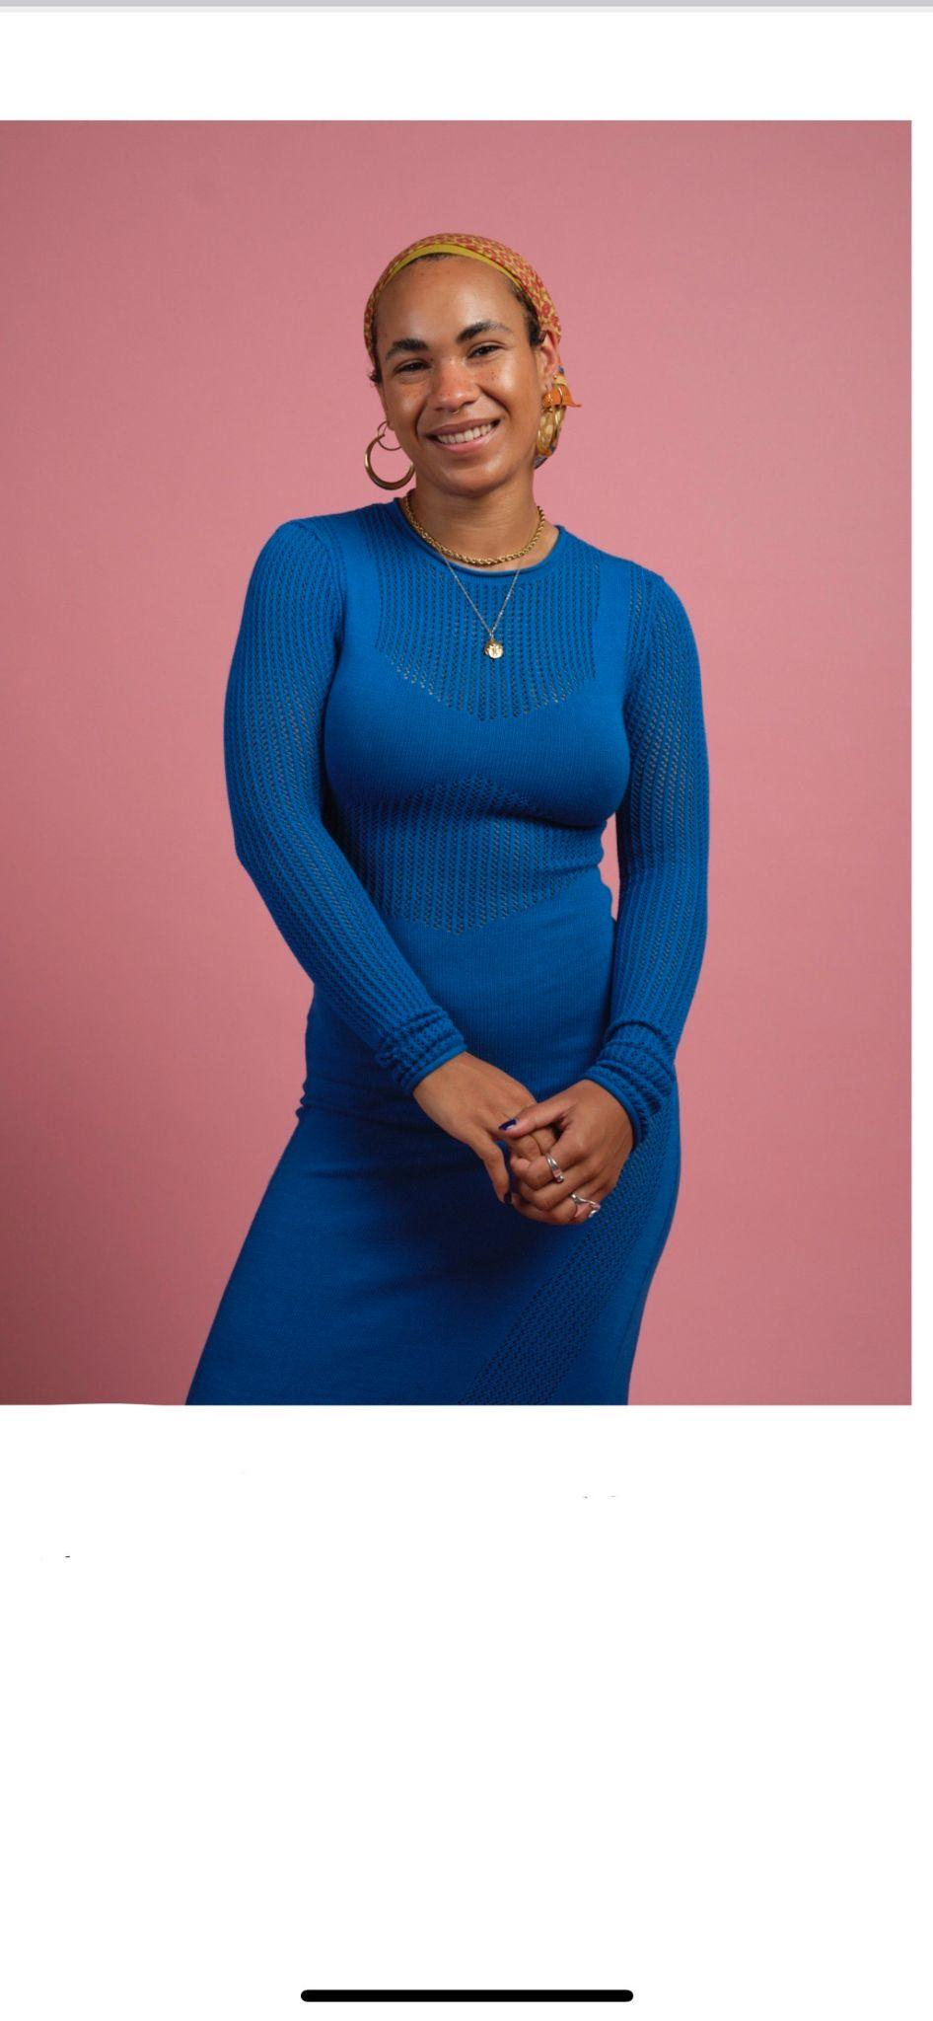
Folly
Notes:
Slide 10: Taking preventative measures
Folly found out she had a changed gene when she was 24, after a year and a half of tests.
Both her mum and grandma had cancer. When her mum was diagnosed, doctors found she had a changed gene, meaning Folly might have inherited it too.
Having a changed gene gave Folly a high risk of getting breast cancer in the future.
To lower that risk, she chose to have surgery to remove both of her boobs – so most of the breast tissue – greatly reducing her chances of getting breast cancer.

Slide 11
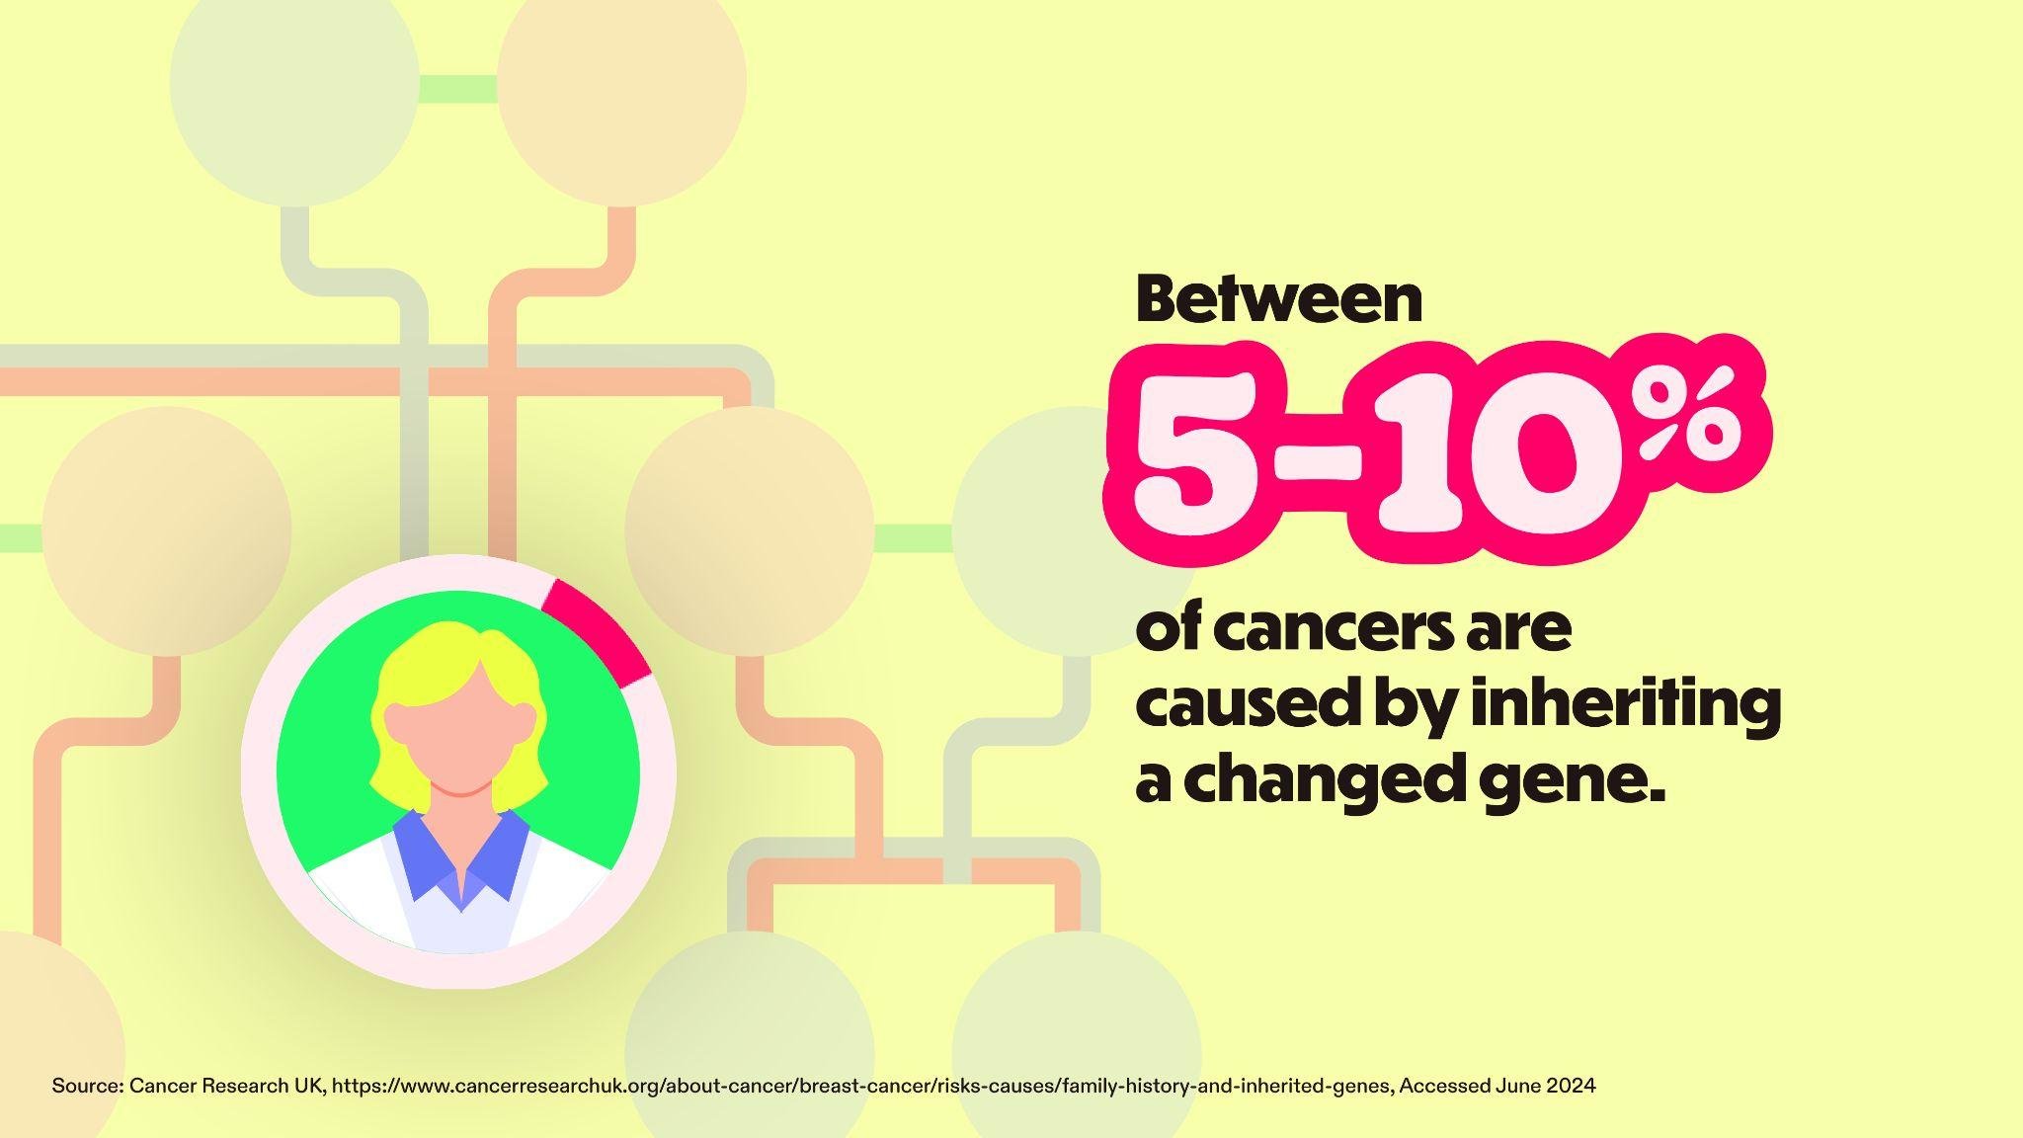
Notes:
Slide 11: Inherited risk statistics
Now Folly’s story isn’t unique, but you might be surprised to know that only about 5 – 10% of breast cancers are caused by inheriting a changed gene. In fact, most cancers are not inherited.
If you are worried about a strong history of cancer in your family, talk to your GP.

Slide 12
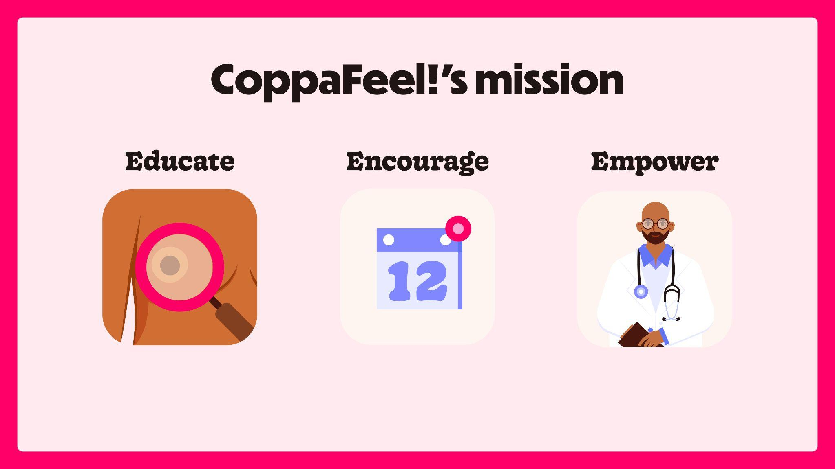
Notes:
Slide 12: Our mission
CoppaFeel!’s mission is all about the early diagnosis of breast cancer. The charity was founded in 2009 by Kris Hallenga and her twin sister Maren, after
Kris was diagnosed with incurable (stage 4/secondary) breast cancer at the age of 23. Kris was struck by the limited information available for young people and so, CoppaFeel! was born.
That’s why I’m delivering this lesson today to educate, encourage and empower you!
Educate you on the signs of breast cancer
Encourage you to check your chest monthly,
Empower you to talk to your GP if you ever notice anything that’s not normal for you.

Slide 13
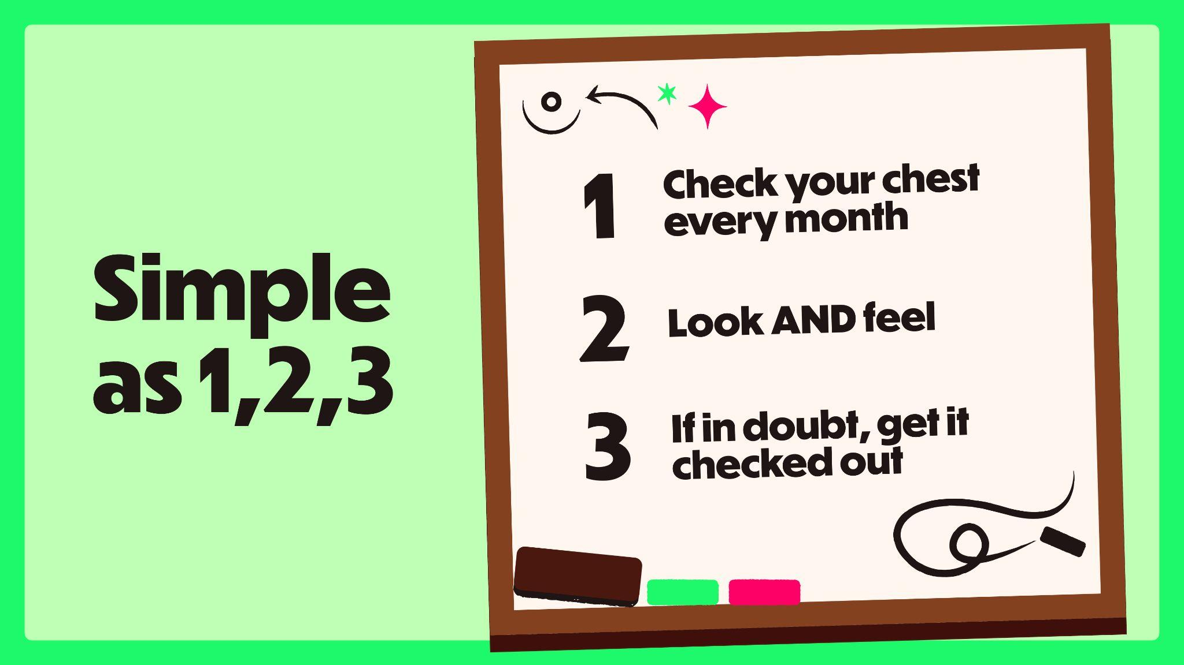
Notes:
Slide 13: As simple as 1,2,3
Well, it’s as simple as 1, 2, 3:
Check your chest every month
Both look AND feel, and;
If in doubt, get it checked out and talk to your GP.
If breast cancer is caught early, treatments are more effective, and survival rates are higher.
What you can see is as important as what you can feel, so remember to look AND feel when checking your chest.

Slide 14
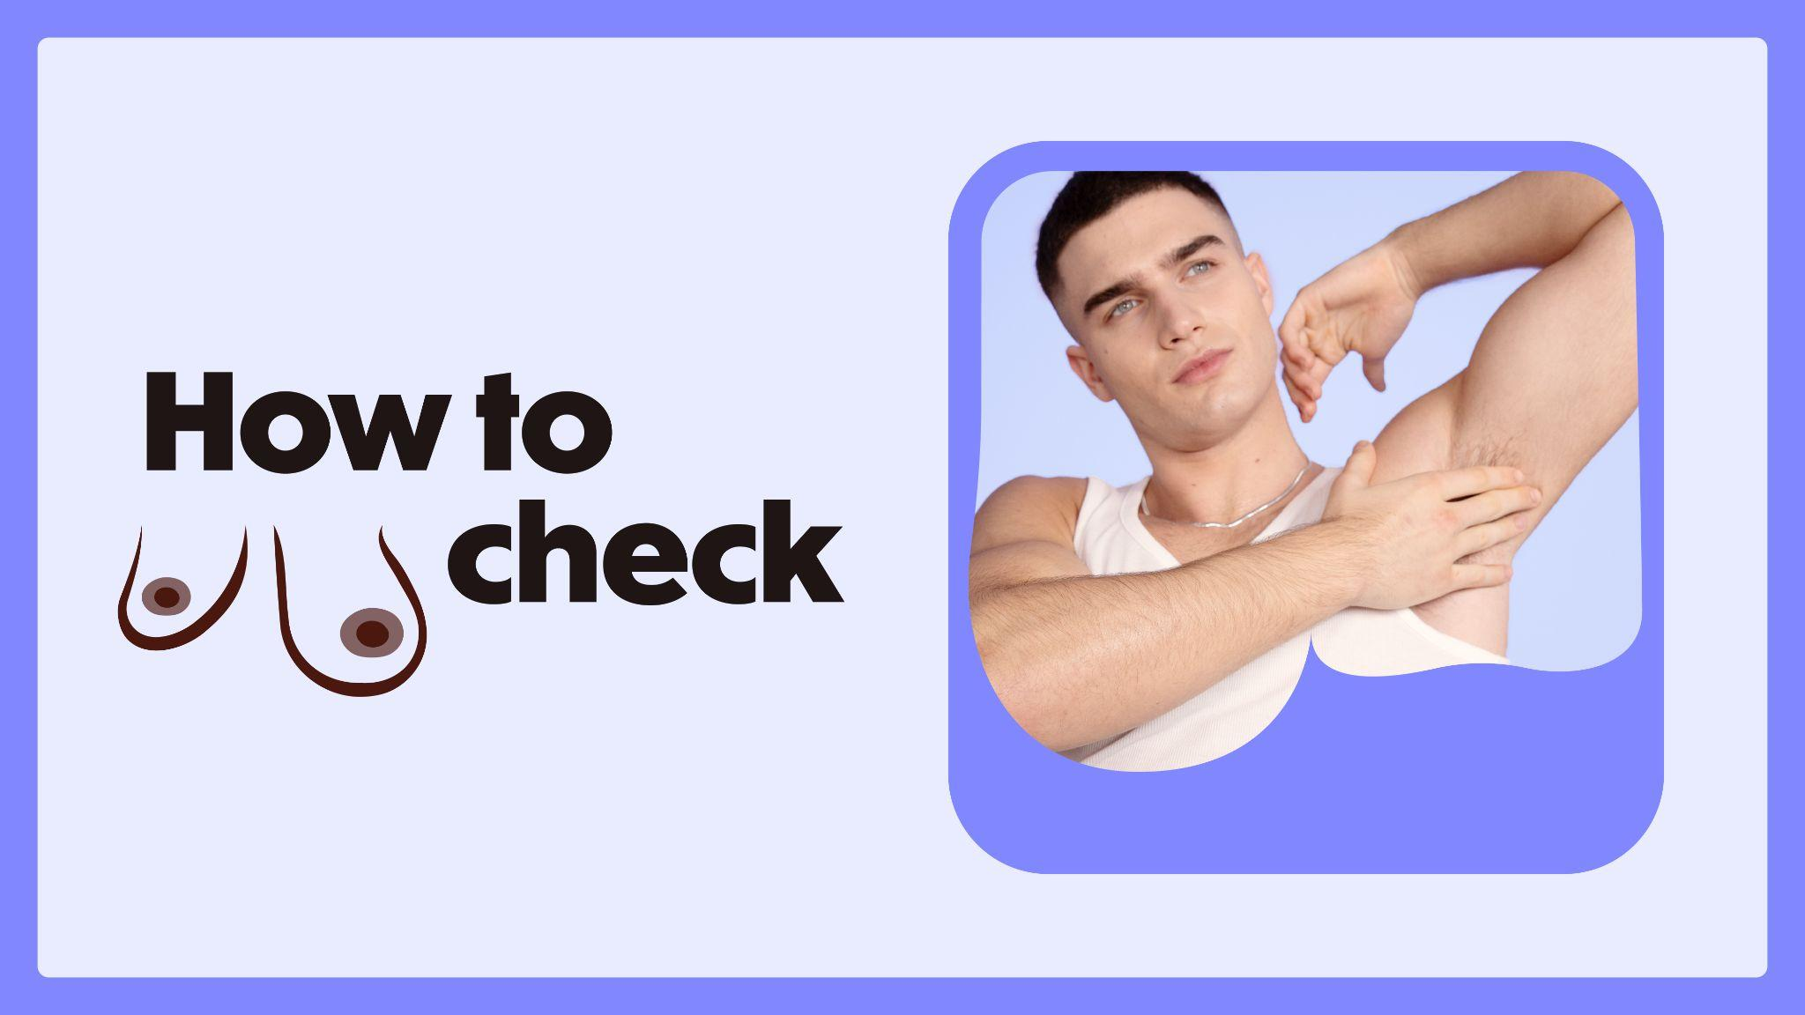
Notes:
Slide 14: How to check
There isn’t a specific way to check and everyone’s ‘normal’ will be different.
You can check in any way that feels right for you – in the shower, when you’re lying down in bed or in the mirror when you’re getting dressed.
The key is to make it part of your normal routine, so you’ll notice any unusual changes quickly.
By checking every month, you’ll feel more confident about knowing what’s normal for you. Everyone has to start somewhere, so don’t worry if you don’t feel confident right away.
To give you some inspiration, let’s have a look at how you can make chest-checking a part of your routine…

Slide 15
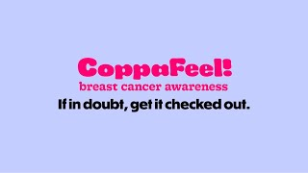
Notes:
Slide 15: How To Check video
[Hit the ‘play’ button or use the spacebar to play the checking video.]
Video problems?
If you’re having issues with the video playing in PowerPoint, play the video through your web browser via YouTube: https://www.youtube.com/watch?v=mv4gT6P5eN0&feature=youtu.be
Or if you want to re-embed the video into PowerPoint go to insert > video > online film > enter this URL https://www.youtube.com/watch?v=mv4gT6P5eN0&feature=youtu.be.

Slide 16

Notes:
Slide 16: Look and Feel
What you can see is as important as what you can feel, so remember to look and feel when checking your chest.
[Classroom interaction]
Can anyone remember any of the signs of breast cancer shown in the video?
[Pause for answers. If they need encouraging say:]
…so, the first sign of breast cancer most people notice is a lump or some thickening of the breast tissue, but this isn’t the only sign. What other signs do you think we might need to be aware of?
[We want to encourage them to share any signs of breast cancer they picked up from ‘The Chest Checklist’ video. You’ll want to repeat back whatever answers the audience shout out e.g. ‘skin rashes?’ – you might want to respond with: ‘ok, so you picked up a rash as a potential sign of breast cancer…can anyone else tell me another sign you picked up from the video?’]

Slide 17
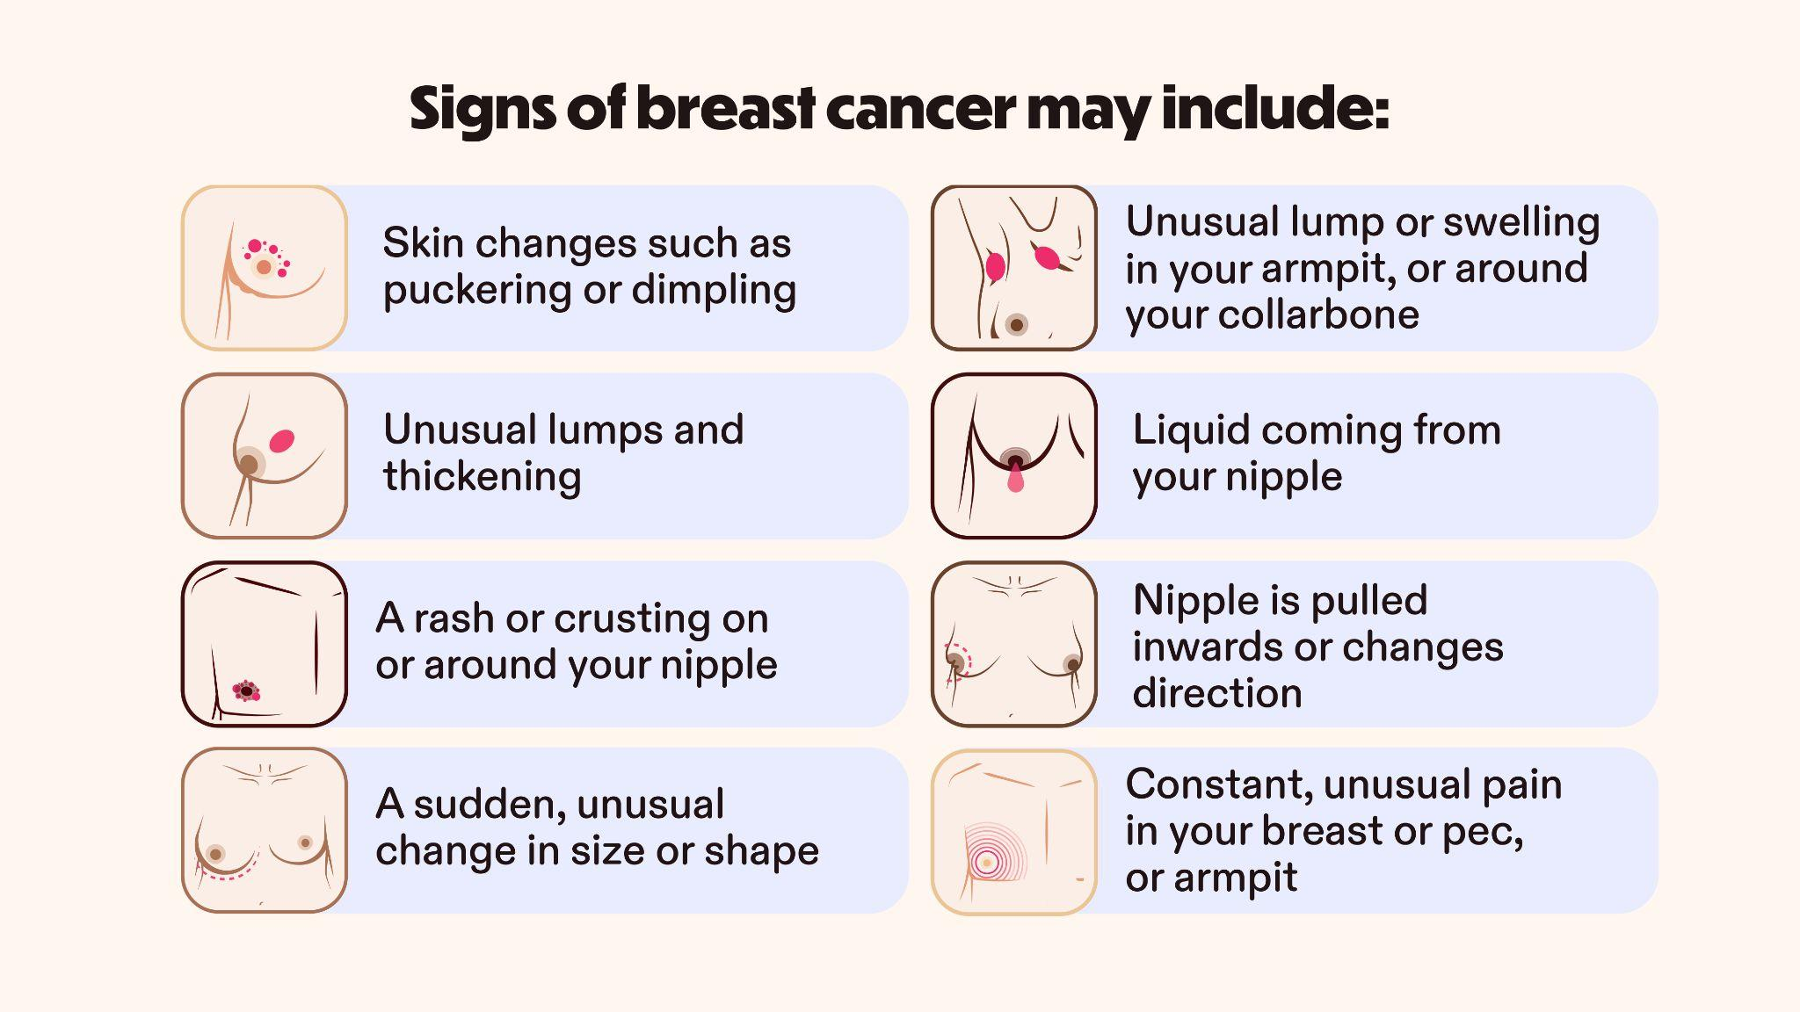
Notes:
Slide 17: Signs of breast cancer
Signs of breast cancer may include any of the things shown here on screen, or a mix of these.
Some of the signs you would only notice from looking at your chest, like liquid coming from your nipple, or a rash or crusting on or around your nipple.
Then there are signs you would only notice from having a feel, like unusual lumps and thickening.
These signs may look different on your skin tone or body. That’s why it’s important to get to know your own body, and what looks and feels normal for you.
Now don’t worry, you don’t have to remember all the signs; CoppaFeel! have created handy checking cards and shower stickers to help you get clued up on the signs of breast cancer…
This is a good opportunity to signpost to, or hand out some CoppaFeel! resources for students to take away with them.

Slide 18

Notes:
Slide 18: Natural changes
Our bodies are always changing.
Chests come in all shapes and sizes. The size of your chest doesn’t affect your risk of breast cancer.
You may have different sized breasts, nipples that point in different directions or nipples with hair around them. If they’ve always been that way and it’s normal for you, then you don’t need to worry.
If you have periods, you might notice natural changes in your chest because of changes in your hormones during your monthly cycle. It’s normal for your breasts to feel tender, sore or swollen around your period.
And finally, some lumps are perfectly normal, but if you get a new lump or a lump comes back, contact your GP.
To find out more about natural chest changes visit the CoppaFeel! website.

Slide 19

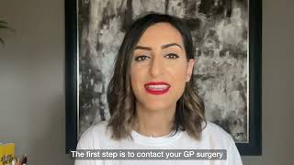
Notes:
Slide 19: If in doubt, get it checked out.
[Read before you play the video]: If you’re ever worried about an unusual change in your chest, book an appointment with a GP.
Some people worry that they’re ‘wasting’ their GP’s time but, they want to hear from you!
You might be relieved to hear that many people who visit the GP to get checked out don’t have breast cancer, but it’s always best to get checked properly at the earliest point just to be sure.
You might be wondering what happens at an appointment, so here’s Dr Krishan [pronounced: Krish-an] to tell you more.
[Hit the ‘play’ button or use the spacebar to play the ‘What to do if you are worried about unusual changes’ video.]
- - - - - - -
Video problems?
If you’re having issues with the video playing in PowerPoint, play the video through your web browser via YouTube: https://youtu.be/3SIMTLjjkvM
Or if you want to re-embed the video into PowerPoint go to insert > video > online film > enter this URL https://youtu.be/3SIMTLjjkvM

Slide 20
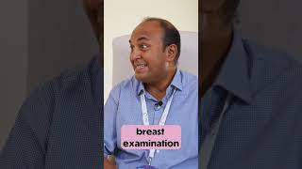
Notes:
Slide 20: What is a chaperone?
[Read before you play the video]: When you attend an NHS appointment for breast changes, you are entitled to a chaperone. Here’s a video which explains what a chaperone is.
[Hit the ‘play’ button or use the spacebar to play the ‘What is a chaperone?’ video.]
Video problems?
If you’re having issues with the video playing in PowerPoint, play the video through your web browser via YouTube: https://youtube.com/shorts/wIJQ5Kn0mRM?feature=share
Or if you want to re-embed the video into PowerPoint go to insert > video > online film > enter this URL https://youtube.com/shorts/wIJQ5Kn0mRM?feature=share

Slide 21
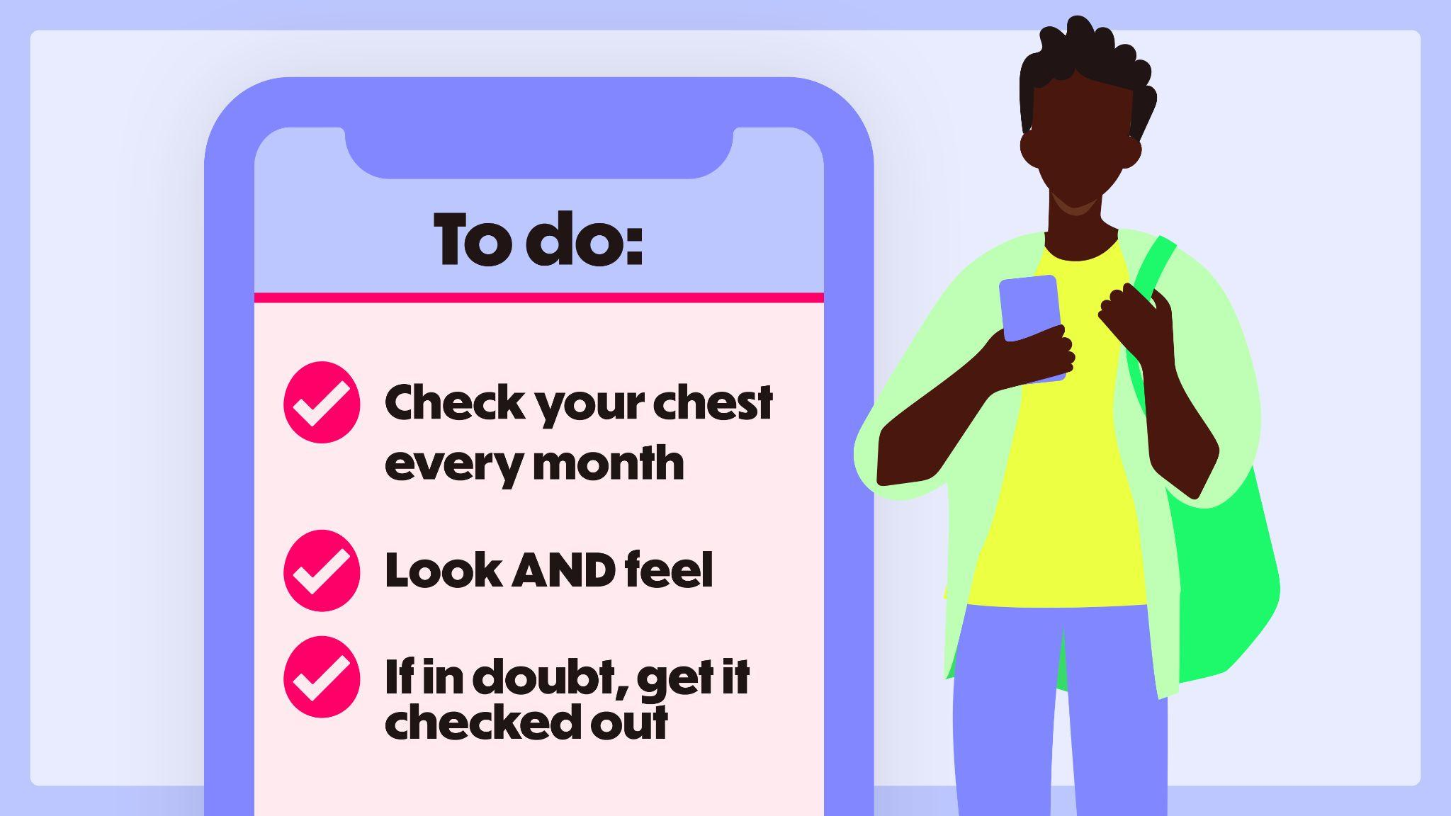
Notes:
Slide 21: Recap
So let’s recap.
Remember, checking your chest is as easy as 1, 2, 3:
One, check your chest every month
This helps you to know what your body looks and feels like, so you’ll notice any unusual changes quickly. You can check in the shower, when you are getting dressed, while applying lotion, or lying down in bed – just make it part of your normal routine. Remember, there isn’t a specific way to check and everyone’s ‘normal’ will be different.
Two, Look and Feel.
Many of the signs of breast cancer are changes you would only notice by seeing how your chest looks so we recommend coppin’ a feel and taking a look during your monthly checks. Remember, everyone has breast tissue which goes from your rib cage, all the way up to your collarbone and under your armpits, including your nipples, so check this whole area.
And Three, if in doubt, get it checked out.
Early detection is the best form of defence. If you find something that’s unusual for you, don’t panic. There are lots of reasons why there might be changes but it’s always best to get it checked out by the GP.
For more information about anything I’ve covered today head to the CoppaFeel! website, coppafeel.org.

Slide 22
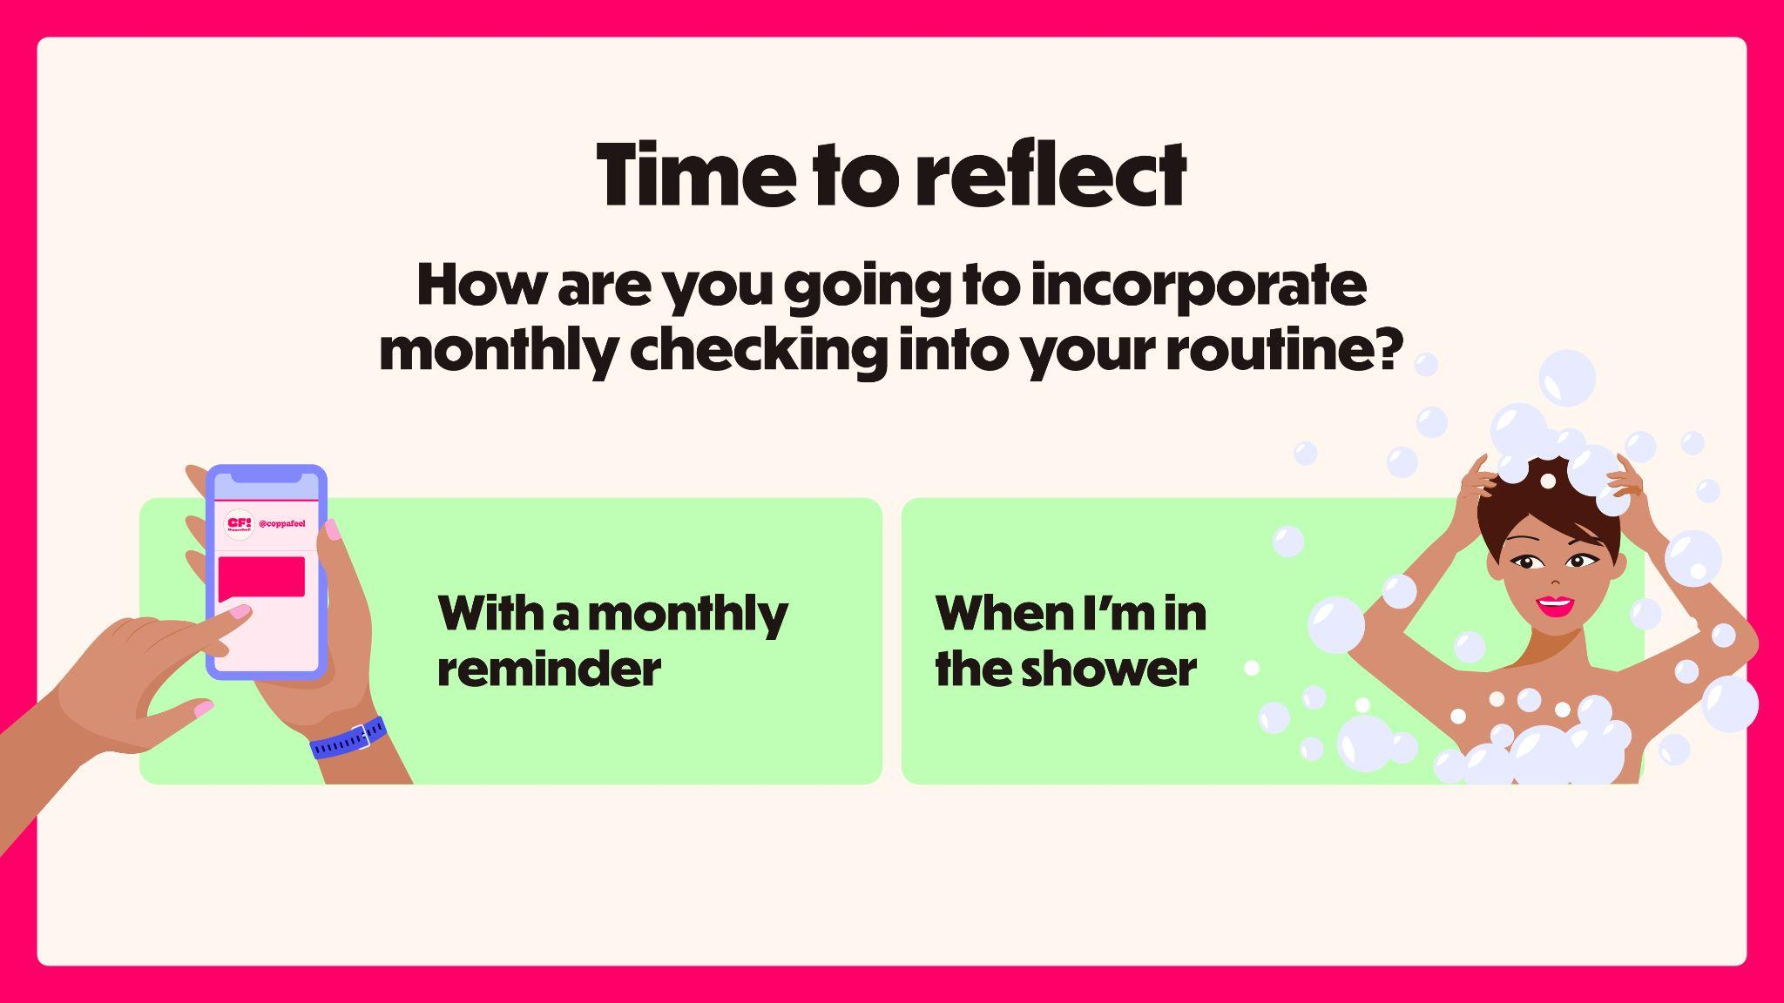
Notes:
Slide 22: Reflection (5 mins)
Now I want you to take a minute to reflect on what you’ve learnt. Have a think about how you are going to incorporate monthly checking into your routine.
[Give them a few minutes to reflect in their own time]
Is anyone happy to share their thoughts with me?
[If no one responds, you might want to share:]
You might want to check in the shower, CoppaFeel! have handy shower stickers which can help to remind you.
You might want to check on the first of the month, and set up a calendar or email reminder, which you can do via CoppaFeel!’s Self-Checkout tool.
You can also sign up for free monthly text reminders by texting NORMAL to 82228, and you’ll get a reminder on the first of the month.

Slide 23
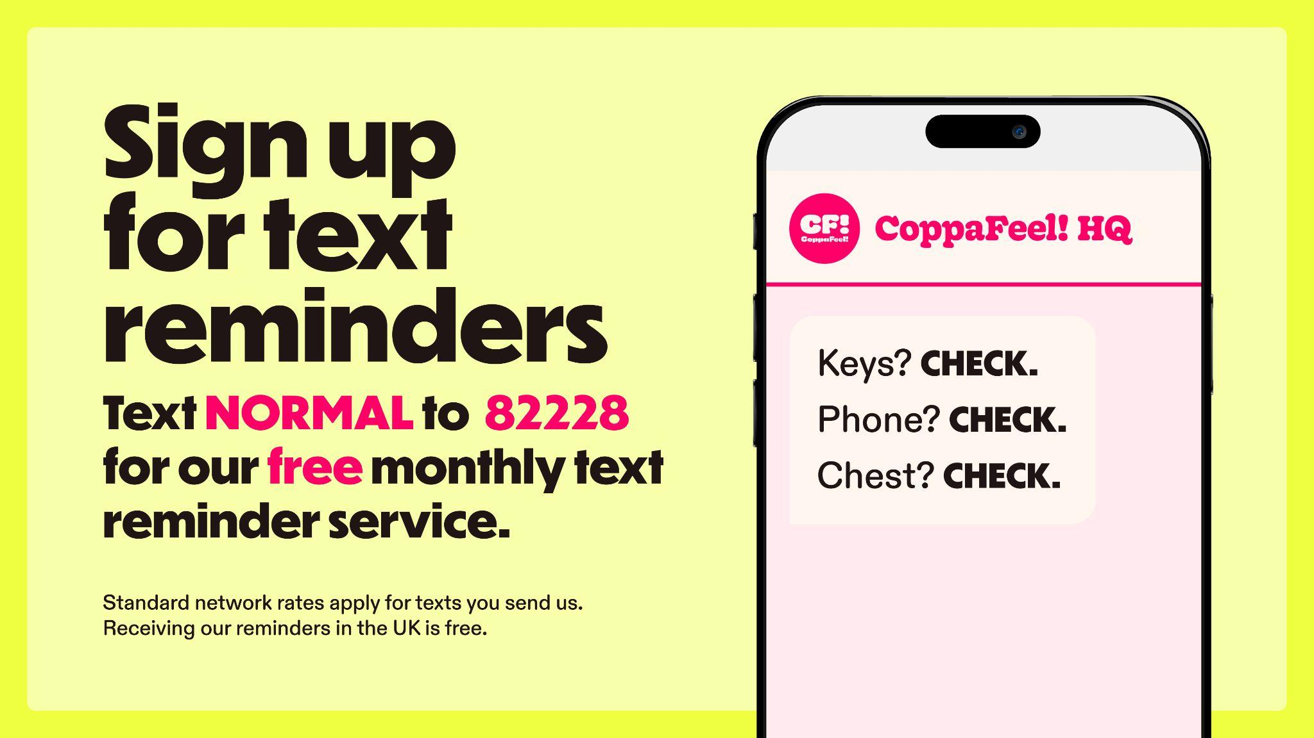
Notes:
Slide 23: Text reminder service
One of the most common reasons for people not checking monthly is that they forget, so CoppaFeel! have some fun ways to remind you:
They can send you a text reminder for free every month to get you checking. Text NORMAL to 82228 to sign up and get a text from once a month. They are usually a little bit silly and include a joke or poem.
One of the most common places people check is in the shower, so they also have shower stickers to remind you to have a good look and feel when you lather up.
Don’t forget, you can grab one from me on your way out.

Slide 24
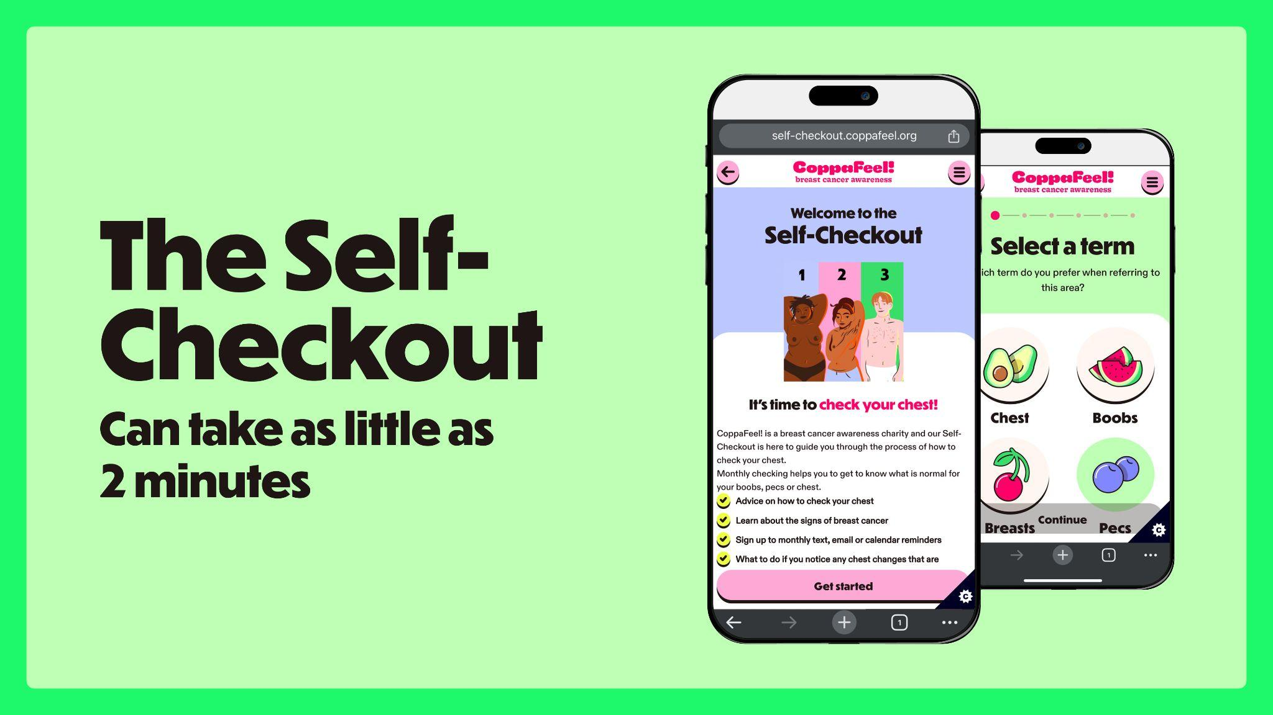
Notes:
Slide 24: The Self-Checkout
CoppaFeel! also have a simple interactive tool which guides you through the process of checking, with handy tips and tricks along the way, animations, as well as the option to choose your preferred term for your chest.
Head to coppafeel.org to try it out for yourself.

Slide 25
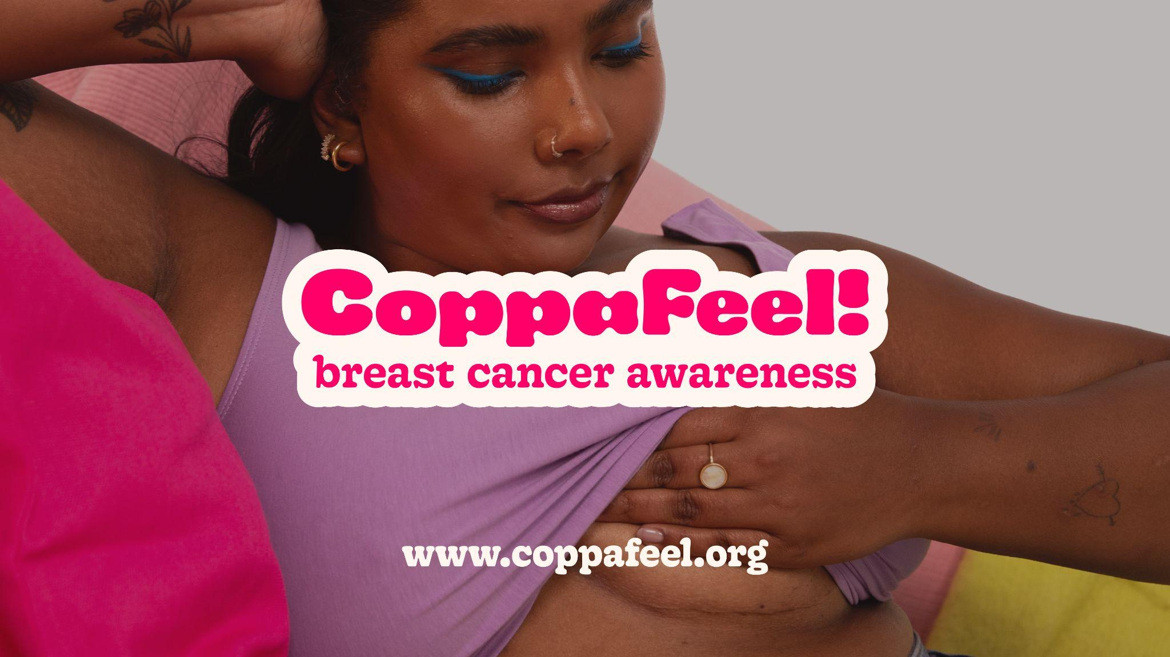
Notes:
Slide 25: End
I hope you’re all feeling more educated and empowered after this lesson to go away and making chest checking a part of your monthly routine.
If you’re ever worried about an unusual change in your chest, book an appointment with a GP.
If you would like more information after this lesson, head to CoppaFeel!’s website (coppafeel.org) which has loads of useful guidance and information. You can also come and grab some handy checking resources from me.

Slide 26

Notes:
Slide 26: Follow CoppaFeel! on social media
I’ll keep this up for anyone who’d like to follow CoppaFeel! on socials.
[Woo! THANK YOU for helping us educate more people about the importance of chest checking and potentially, saving lives! You’ve just done something BRILLIANT so we recommend treating yourself and take a moment to recognise your contribution to our life-saving mission.]

